Slide 1
Italian Tech Tree
Proposal for a new independent italian tech tree

Slide 2
Fighters

Slide 3
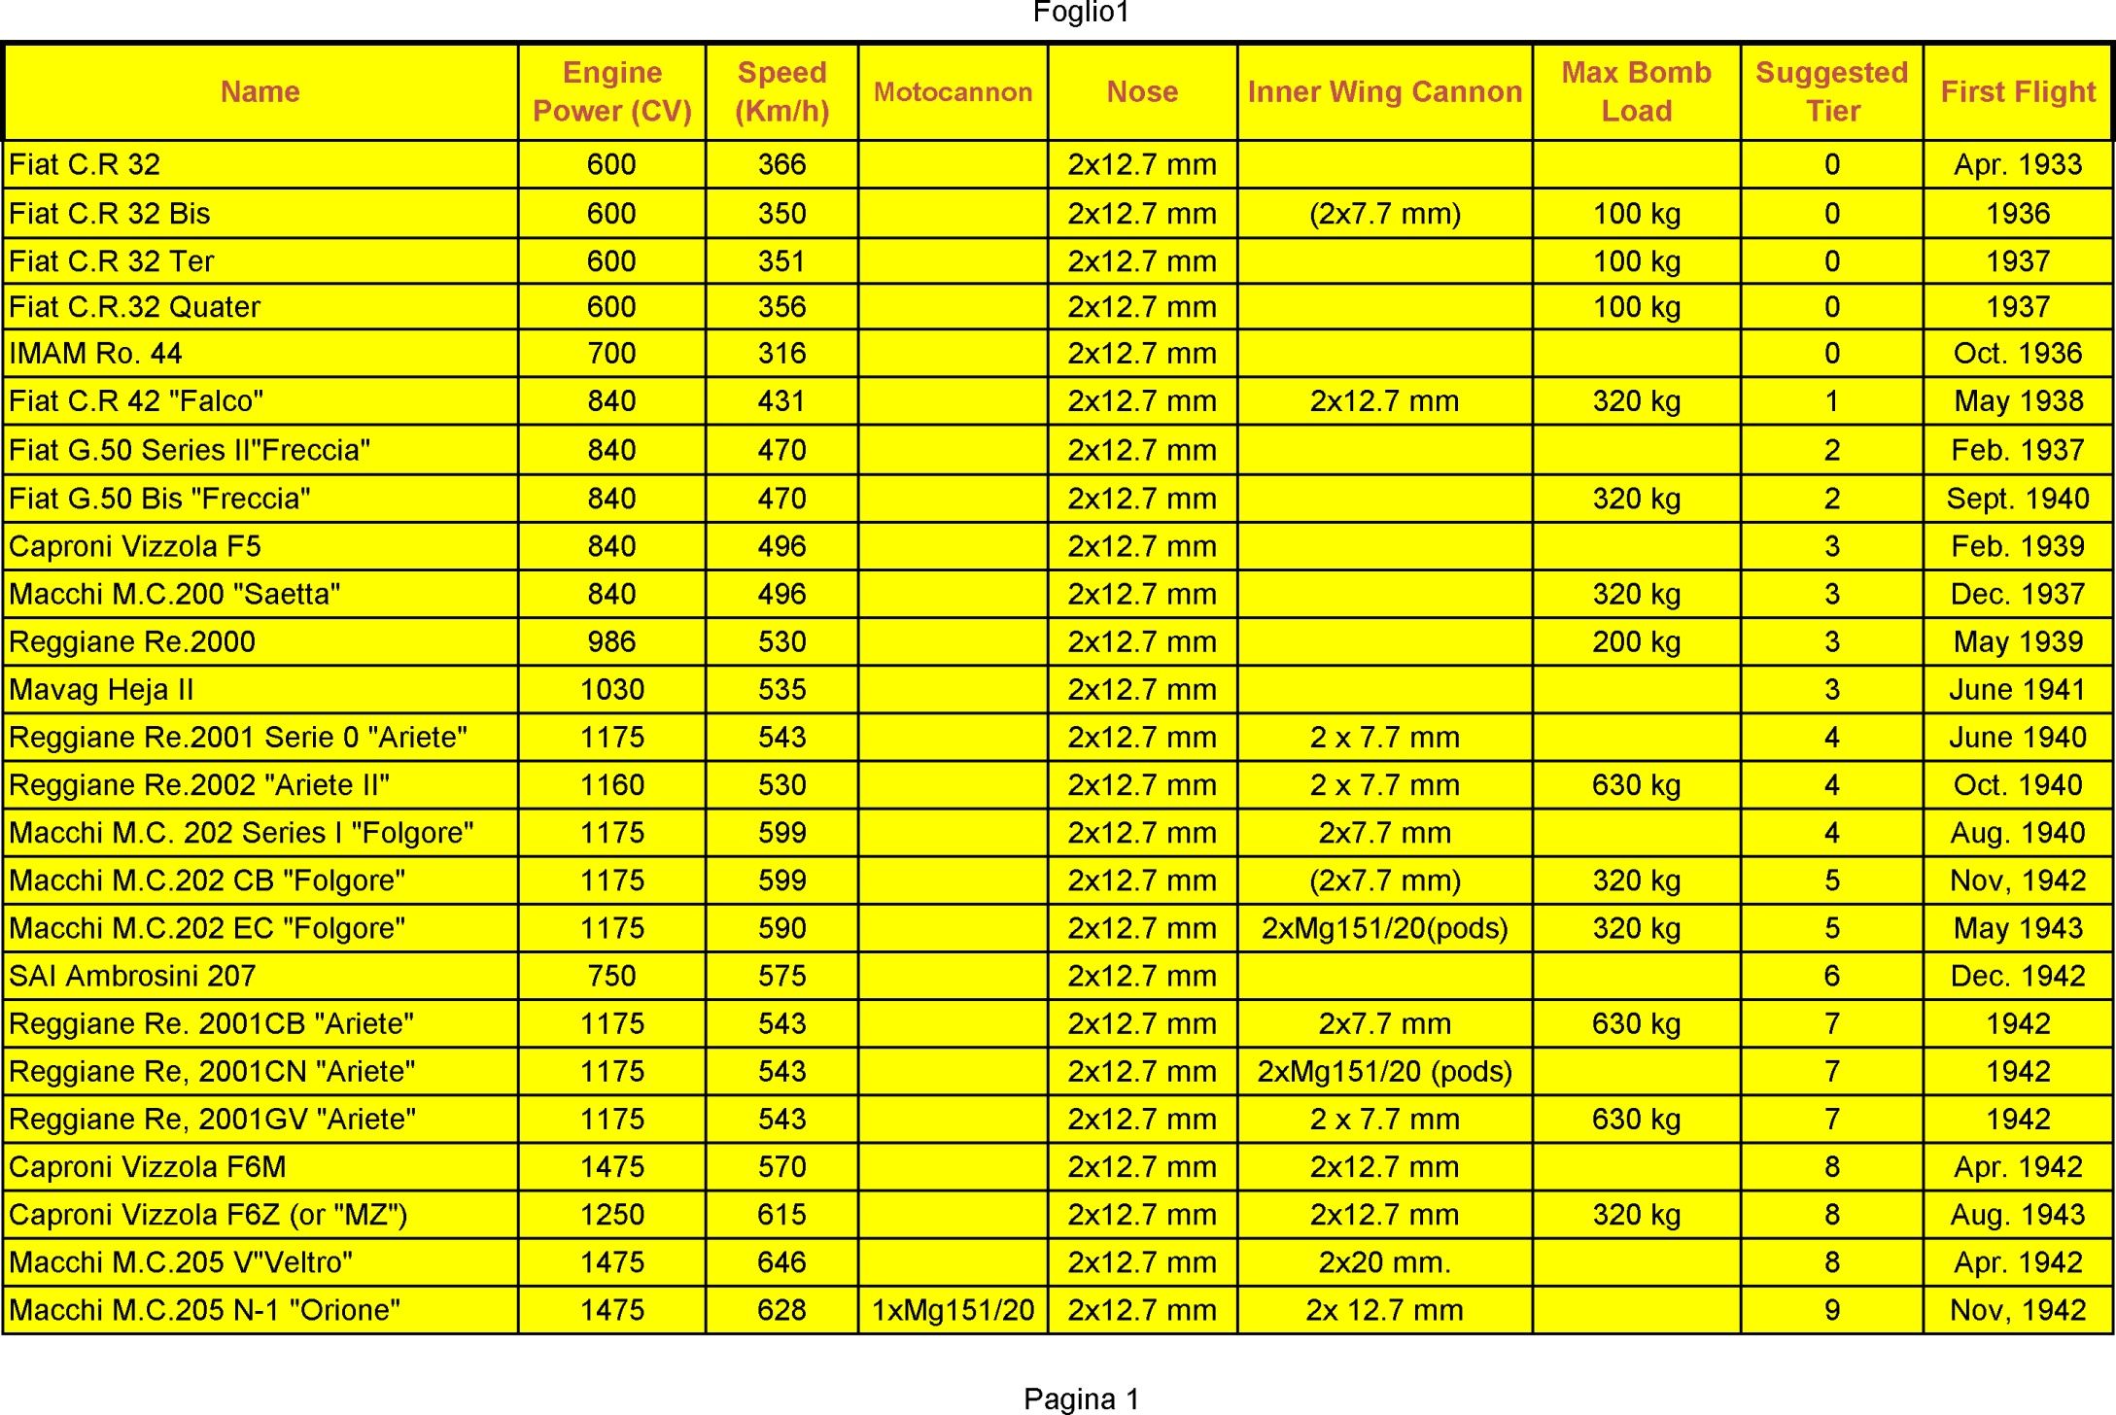

Slide 4
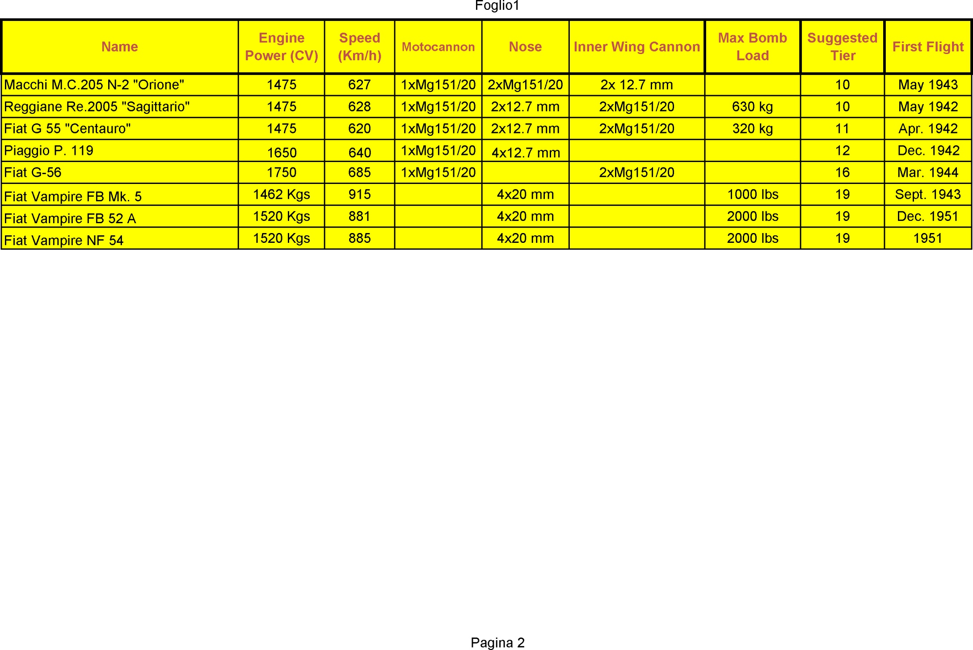

Slide 5
Heavy Fighters

Slide 6
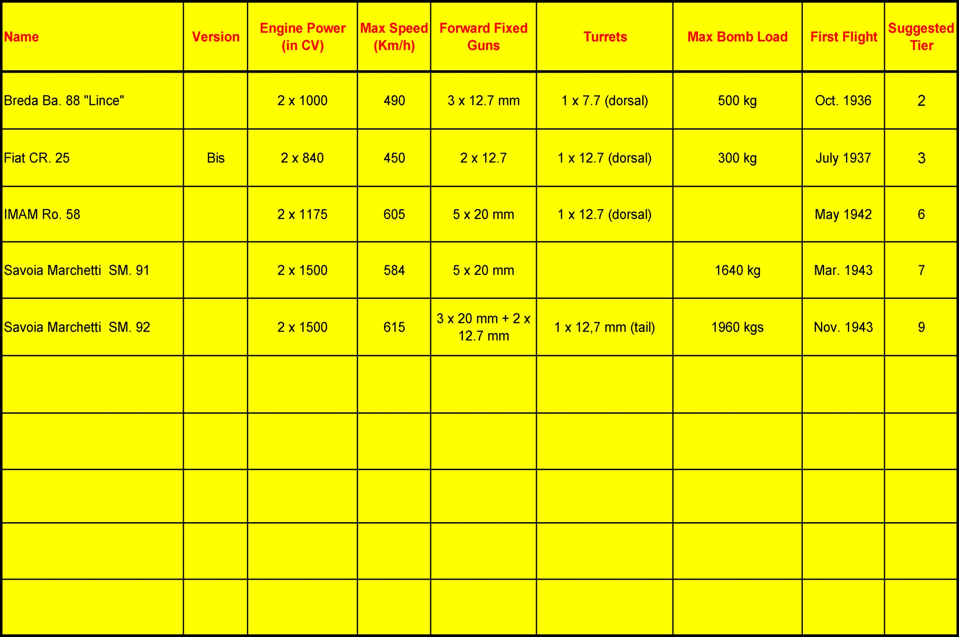

Slide 7
Sea Bombers

Slide 8
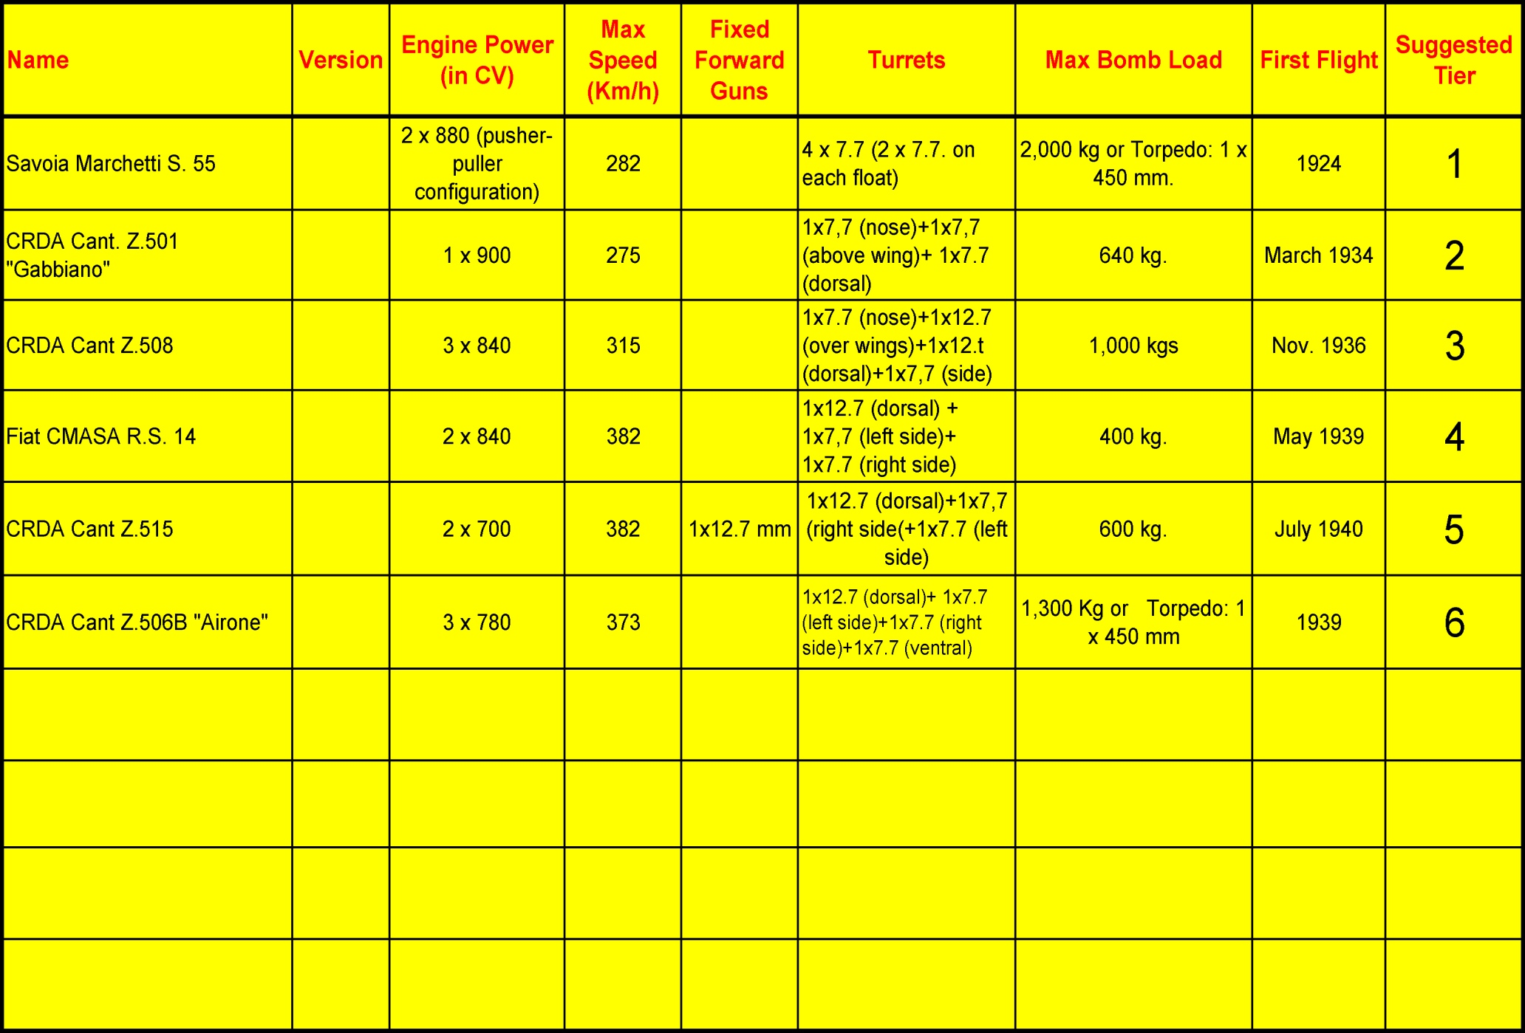

Slide 9
Assault/Dive Bombers

Slide 10
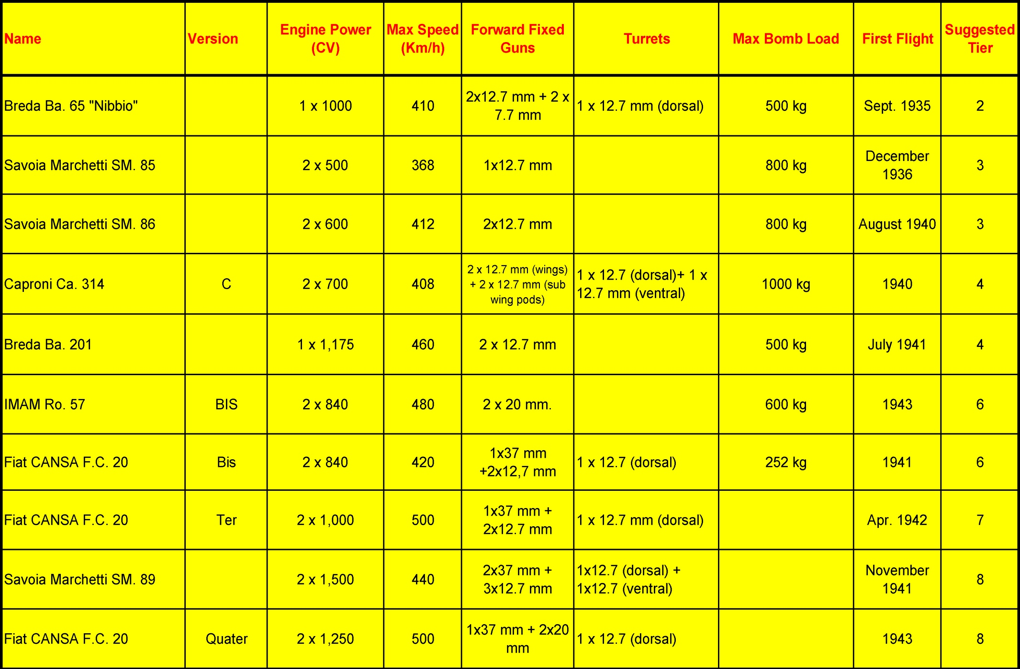

Slide 12
Medium/Heavy Bombers

Slide 13
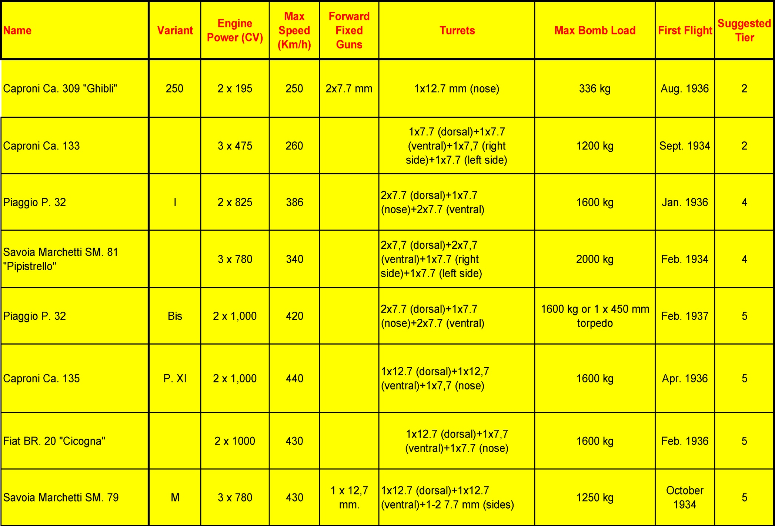

Slide 14
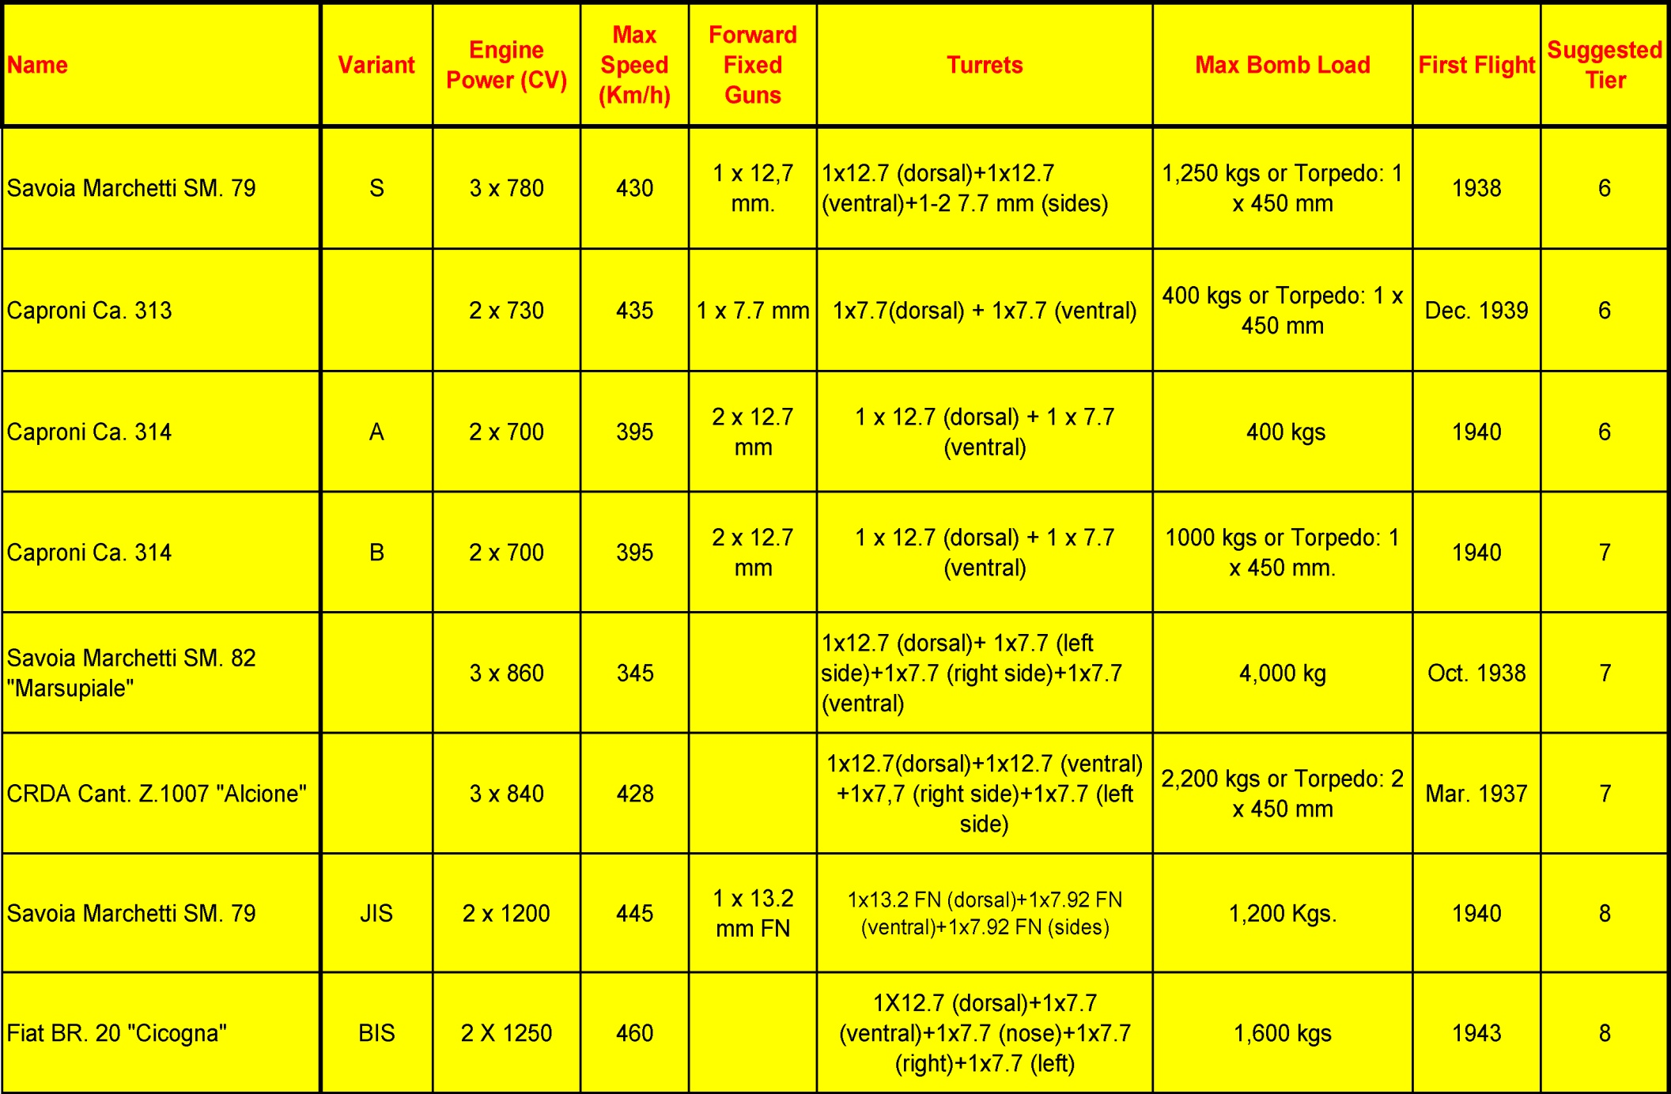

Slide 15
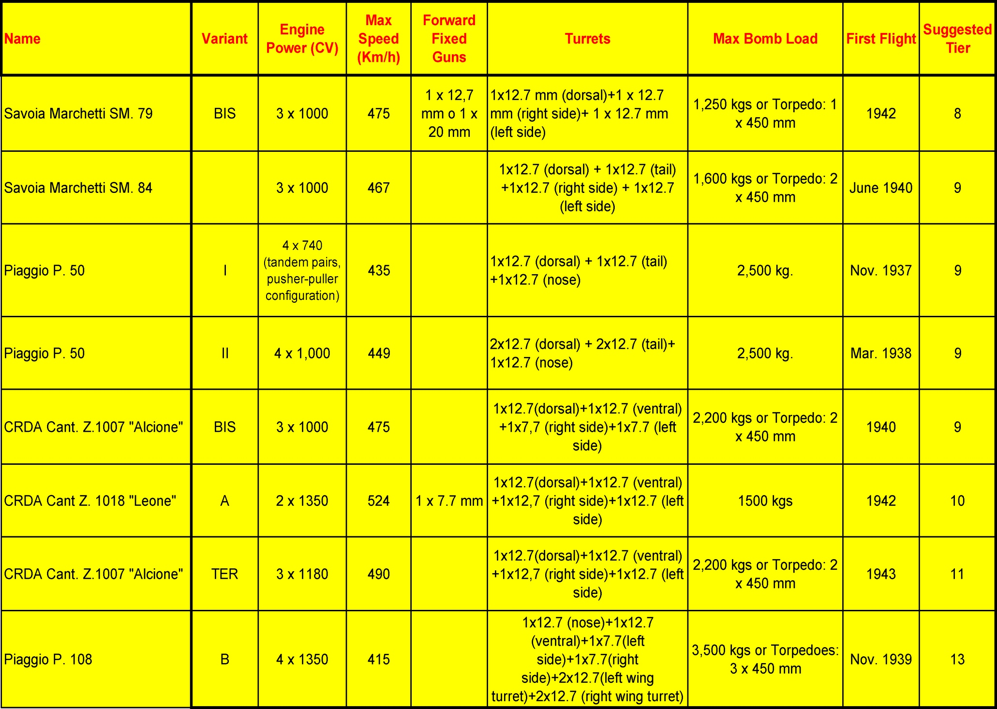

Slide 16
Premiums

Slide 17
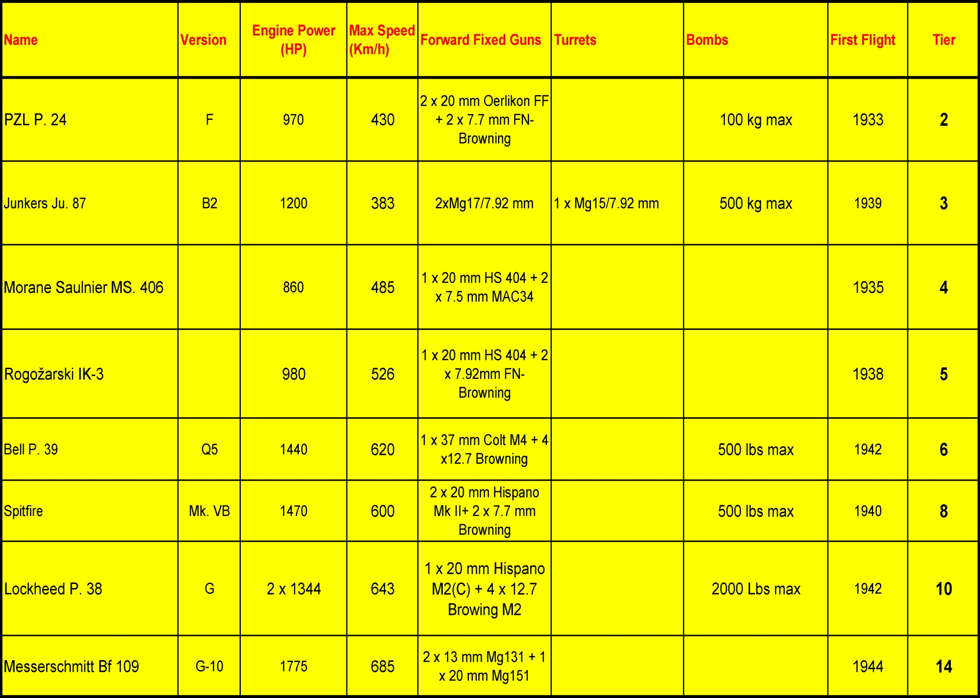

Slide 18
Aircrafts Data Sheets

Slide 19
Fighters

Slide 20
Fiat CR 32 Single-engine biplane fighter, the first prototype (serial MM 201) flew for the first time on April 28th, 1933, test pilot was Brach Papa. CR 32 was one of the top protagonists in Spain during 1936-1939 Civil War, as well as in acrobatic shows in Europe in those few years before WW2. Agile, well armed (for those times) it was the most qualifying project of Celestino Rosatelli (as the CR of the plane name stays for). It was one of most exported planes of 1930’s, bought even by China, in the need to get modern planes to fight Japanese invasion. At the beginning of WW2 the CR 32 was already obsolete, but it still equipped many Regia Aeronautica (Italian Royal Air Force) fighter squadrons, and they fought in Lybia, Italian Eastern Africa, Crete. After Creta was conquered by Axis troops, CR 32 was relegated to fighting train duties.

Slide 21
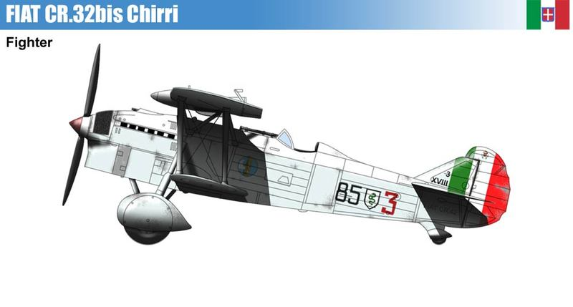
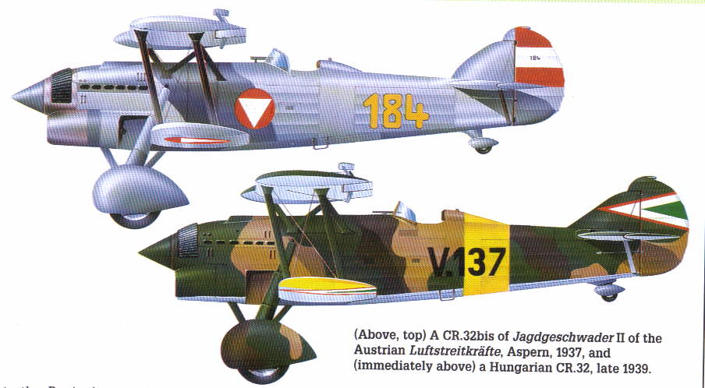
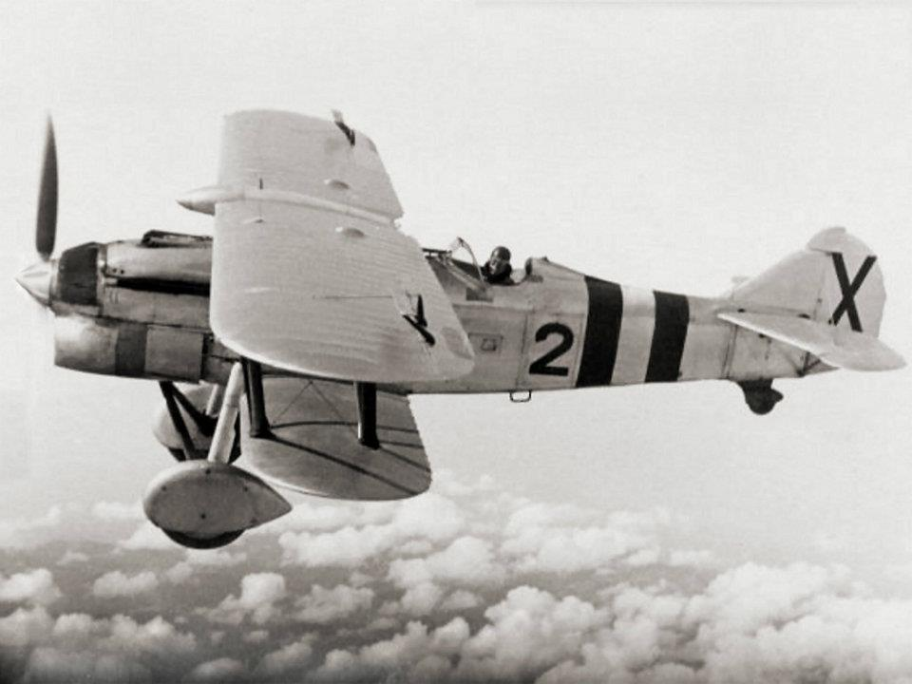
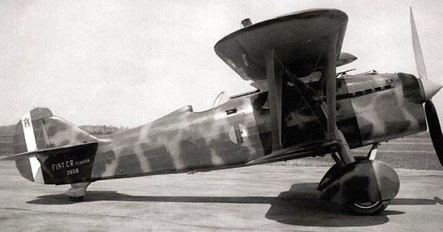
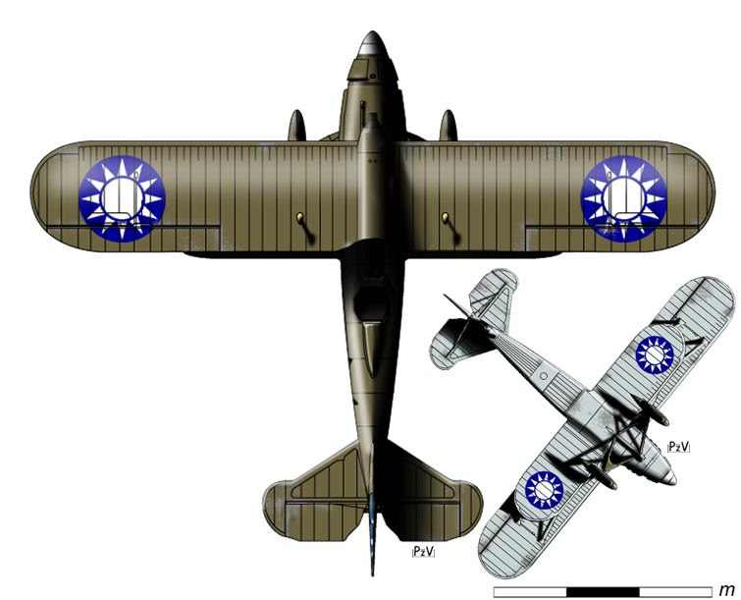
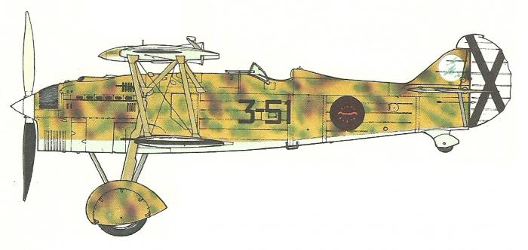
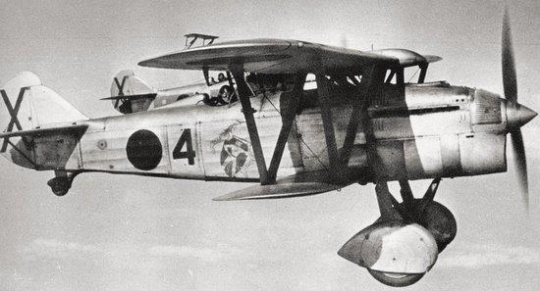
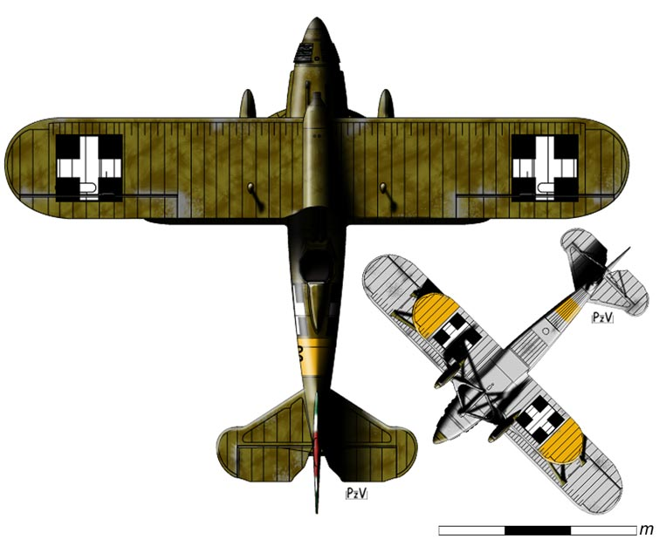
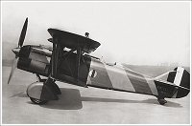
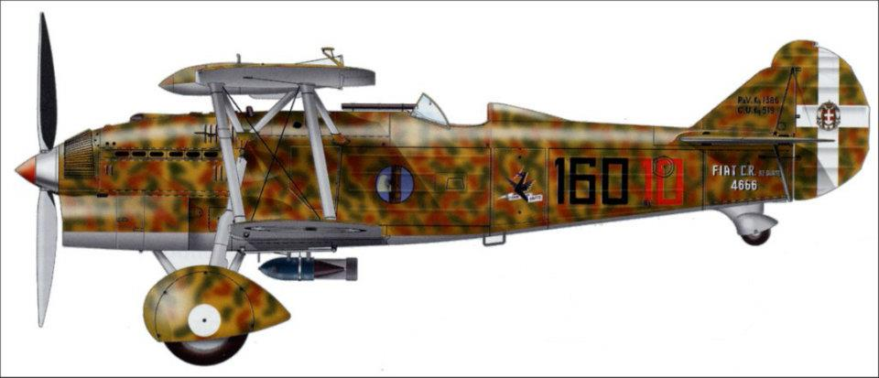

Slide 22
Fiat C.R. 32
Name: |  |  | Fiat CR 32
Type: |  |  | Single-Engine Biplane Fighter
Crew: |  |  | 1
First Flight: |  |  | April 1933
In-Service Date: |  |  | 1934
Length (m) |  |  | 7,45
Wingspan (m): |  |  | 9,50
Wing Area (Sq. M) |  |  | 22,10
Heighth (m) |  |  | 2,63
Empty Weight (kg) |  |  | 1.325
Loaded Weight: |  |  | 1.850
Climb Rate: |  |  | 7 min 30 sec to 4000 m
Engines: |  |  | Fiat A. 30 R.A.
Power: |  |  | 600 CV (441 KW)
Take Off (m)
Landing (m)
Max Speed (Km/h) |  |  | 366
Cruising Speed (km/h)
Range (km) |  |  | 780
Ceiling (m): |  |  | 9.200
Users: |  |  | Italy, China,
Max Bomb Load
Possible Loads

Slide 23
Fiat C.R. 32 Bis
Name: |  |  | Fiat CR. 32 Bis
Type: |  |  | Single-Engine Biplane Fighter
Crew: |  |  | 1
First Flight: |  |  | 1936
In-Service Date: |  |  | 1936
Length (m) |  |  | 7,45
Wingspan (m): |  |  | 9,50
Wing Area (Sq. M) |  |  | 22,10
Heighth (m) |  |  | 2,63
Empty Weight (kg) |  |  | 1.400
Loaded Weight: |  |  | 1.970
Climb Rate: |  |  | 5 min 30 sec to 3000 m
Engines: |  |  | Fiat A. 30 R.A. Bis
Power: |  |  | 600 CV (441 KW)
Take Off (m)
Landing (m)
Max Speed (Km/h) |  |  | 350
Cruising Speed (km/h)
Range (km) |  |  | 780
Ceiling (m): |  |  | 8.000
Users: |  |  | Italy, Hungary, Germany, Austria, Spain
Max Bomb Load |  |  | from 1940 variants: 100 kg
Possible Loads |  |  | 1 x 100 kg or 2 x 50 kg or 2 bomb release gears

Slide 24
Fiat C.R. 32 Ter
Name: |  |  | Fiat CR. 32 Ter
Type: |  |  | Single-Engine Biplane Fighter
Crew: |  |  | 1
First Flight: |  |  | 1937
In-Service Date: |  |  | 1937
Length (m) |  |  | 7,45
Wingspan (m): |  |  | 9,50
Wing Area (Sq. M) |  |  | 22,10
Heighth (m) |  |  | 2,63
Empty Weight (kg) |  |  | 1.335
Loaded Weight: |  |  | 1.860
Climb Rate: |  |  | 7 min 40 sec to 4000 m
Engines: |  |  | Fiat A. 30 R.A. Bis
Power: |  |  | 600 CV (441 KW)
Take Off (m)
Landing (m)
Max Speed (Km/h) |  |  | 351
Cruising Speed (km/h)
Range (km) |  |  | 780
Ceiling (m): |  |  | 8.000
Users: |  |  | Italy Spain
Max Bomb Load |  |  | from 1940 variants: 100 kg
Possible Loads |  |  | 1 x 100 kg or 2 x 50 kg or 2 bomb release gears

Slide 25
Fiat C.R. 32 Quater
Name: |  |  | Fiat CR. 32 Quater
Type: |  |  | Single-Engine Biplane Fighter
Crew: |  |  | 1
First Flight: |  |  | 1937
In-Service Date: |  |  | 1937
Length (m) |  |  | 7,45
Wingspan (m): |  |  | 9,50
Wing Area (Sq. M) |  |  | 22,10
Heighth (m) |  |  | 2,63
Empty Weight (kg) |  |  | 1.380
Loaded Weight: |  |  | 1.905
Climb Rate: |  |  | 5 min 10 sec to 3000 m
Engines: |  |  | Fiat A. 30 R.A. Bis
Power: |  |  | 600 CV (441 KW)
Take Off (m)
Landing (m)
Max Speed (Km/h) |  |  | 356
Cruising Speed (km/h)
Range (km) |  |  | 780
Ceiling (m): |  |  | 7.550
Users: |  |  | Italy, Germany, Venezuela, Paraguay, Spain
Max Bomb Load |  |  | from 1940 variants: 100 kg
Possible Loads |  |  | 1 x 100 kg or 2 x 50 kg or 2 bomb release gears

Slide 26
IMAM Ro. 44 Single-engine biplane sea fighter, the first prototype flew for the first time in October 1936, test pilot was Nicolò Lana. It was a heavily modified version of a previous two-seat naval observation plane produced by same IMAM factory, the Ro. 43: max speed does not change too much, just a few knots; but manoeuvrability was greatly improved., and Regia Aeronautica gave the role of fighter to Ro. 44. At the beginning of WW2 the plane was obsolete, and its presence in the Regia Aeronautica army list was reduced to a single squadron, 161a Squadriglia Autonoma, based in Lero, Aegean Sea, with just 7 serviceable aircrafts. After June 1941 the Ro. 44 was assigned to second line duties.

Slide 27
IMAM Ro. 44
Name: |  |  | IMAM Ro. 44
Type: |  |  | Seaplane Fighter
Crew: |  |  | 1
First Flight: |  |  | October 1936
In-Service Date: |  |  | 1937
Length (m) |  |  | 9,71
Wingspan (m): |  |  | 11,57
Wing Area (Sq. M) |  |  | 33,36
Heighth (m) |  |  | 3,55
Empty Weight (kg) |  |  | 1.770
Loaded Weight: |  |  | 2.220
Climb Rate: |  |  | 8 min 40 sec to 4000 m
Engines: |  |  | Piaggio P. X
Power: |  |  | 700 CV (515 KW)
Take Off (m)
Landing (m)
Max Speed (Km/h) |  |  | 316
Cruising Speed (km/h)
Range (km) |  |  | 1.200
Ceiling (m): |  |  | 6.900
Users: |  |  | Italy
Max Bomb Load
Possible Loads

Slide 28
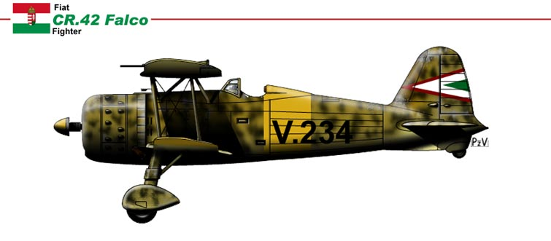
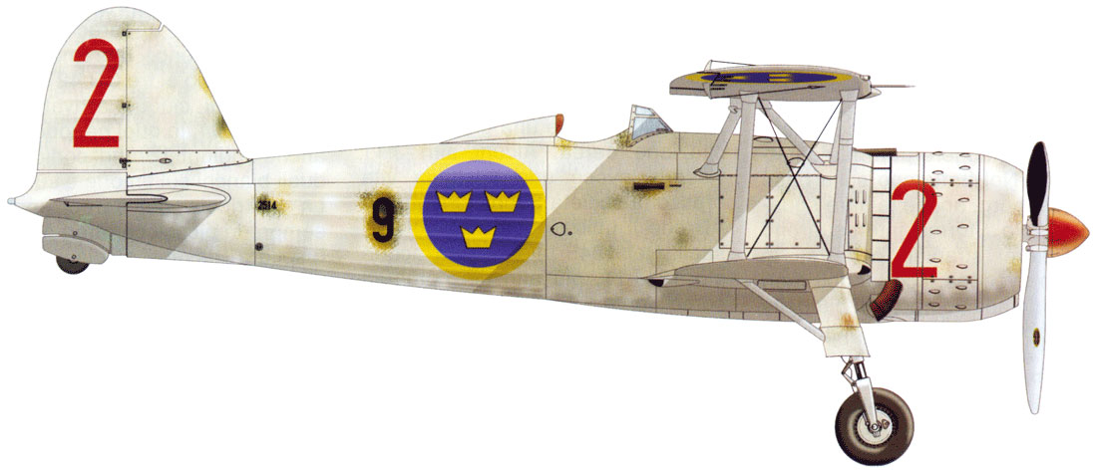
Fiat CR 42 Single-engine biplane fighter, the first prototype flew for the first time on May 23rd, 1938, pilot was Valentino Cus, Fiat’s chief test pilot. The airplane was given the nickname of “Falco” (Hawk in English). It was a strong and manoeuvrable machine, with highly acrobatic flying capabilities. It was surely the best biplane fighters ever produced in large quantities, but it must be said that it entered into service when obviously superior monoplanes, like Hurricane and Messerschmitt Bf 109, had already entered in front line service of RAF and Luftwaffe

Slide 29
Fiat C.R. 42 «Falco»
Name: |  |  | Fiat CR. 42 "Falco"
Type: |  |  | Single-Engine Biplane Fighter
Crew: |  |  | 1
First Flight: |  |  | May 1938
In-Service Date: |  |  | 1939
Length (m) |  |  | 8,30
Wingspan (m): |  |  | 9,70
Wing Area (Sq. M) |  |  | 22,35
Heighth (m) |  |  | 3,35
Empty Weight (kg) |  |  | 1.707
Loaded Weight: |  |  | 2.287
Climb Rate: |  |  | 5 min 26 sec to 4000 m
Engines: |  |  | Fiat A. 74 R.C. 38
Power: |  |  | 840 CV (618 KW)
Take Off (m) |  |  | 220
Landing (m) |  |  | 282
Max Speed (Km/h) |  |  | 431
Cruising Speed (km/h)
Range (km) |  |  | 1.015
Ceiling (m): |  |  | 10.150
Users: |  |  | Italy, Germany, Belgium, Yugoslavia, Sweden, Hungary, Iraq, South Africa (captured)
Max Bomb Load |  |  | 320 kg
Possible Loads |  |  | 2 x 160 kg or 2 x 100 kg or 2 x 50 kg

Slide 30
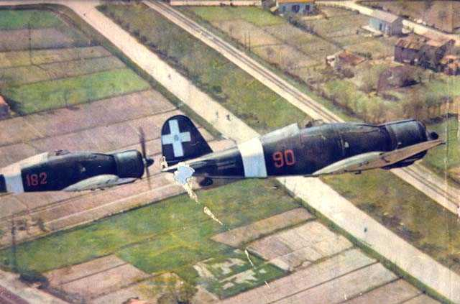
Fiat G. 50 Single-engine monoplane fighter, it was the first monoplane fighter to be accepted by Regia Aeronautica. First prototype (serial MM 334) flew for the first time on April 26th, 1937, pilot was Giovanni De Briganti, CMASA’s (a subsidiary of Fiat) chief test pilot. The airplane was given the nickname of “Freccia” (Arrow in English). Threatened by more powerful neighbour Soviet Union, the small Finland was looking for help outside, and they addressed their searches also to Italy, where they decided to order the new monoplane fighter, the G. 50. It was the first stranger order received for the new aircraft. Among the Finnish aces using Fiat G. 50 fighter there was Ouva Tuominen, with 23 confirmed kills, 15 of which using the G. 50. Afterwards, during WW2, Fiat G. 50 flew and fought in all the most important European war theatre: Albania, Greece, Aegean Sea, North Africa, France, Great Britain, Mediterranean Sea. In 1942 the aircraft was already obsolete, and it was very tough for its pilots to survive. But it was kept in service till the Armistice (Sept. 8th, 1943).

Slide 31
Fiat G. 50 Series II «Freccia»
Name: |  |  | Fiat G. 50 Series II "Freccia"
Type: |  |  | Single-Engine Monoplane Fighter
Crew: |  |  | 1
First Flight: |  |  | February1937
In-Service Date: |  |  | 1938
Length (m) |  |  | 8,03
Wingspan (m): |  |  | 10,99
Wing Area (Sq. M) |  |  | 18,25
Heighth (m) |  |  | 3,28
Empty Weight (kg) |  |  | 1.963
Loaded Weight: |  |  | 2.402
Climb Rate: |  |  | 4 min 38 sec to 4000 m
Engines: |  |  | Fiat A. 74 R.C. 38
Power: |  |  | 840 CV (618 KW)
Take Off (m) |  |  | 225
Landing (m) |  |  | 260
Max Speed (Km/h) |  |  | 470
Cruising Speed (km/h)
Range (km) |  |  | 445
Ceiling (m): |  |  | 10.700
Users: |  |  | Italy, Finland, Spain, Germany
Max Bomb Load
Possible Loads

Slide 32
Fiat G. 50 Bis «Freccia»
Name: |  |  | Fiat G. 50 Bis "Freccia"
Type: |  |  | Single-Engine Monoplane Fighter
Crew: |  |  | 1
First Flight: |  |  | September 1940
In-Service Date: |  |  | 1941
Length (m) |  |  | 8,29
Wingspan (m): |  |  | 10,99
Wing Area (Sq. M) |  |  | 18,25
Heighth (m) |  |  | 3,28
Empty Weight (kg) |  |  | 2.015
Loaded Weight: |  |  | 2.522
Climb Rate: |  |  | 5 min to 4000 m
Engines: |  |  | Fiat A. 74 R.C. 38
Power: |  |  | 840 CV (618 KW)
Take Off (m) |  |  | 225
Landing (m) |  |  | 260
Max Speed (Km/h) |  |  | 470
Cruising Speed (km/h)
Range (km) |  |  | 445
Ceiling (m): |  |  | 10.700
Users: |  |  | Italy, Yugoslavia, Germany
Max Bomb Load |  |  | 320 kg
Possible Loads |  |  | 2 x 160 kg or 2 x 100 kg or 2 x 50 kg

Slide 33
Caproni Vizzola F5
Name: |  |  | Caproni Vizzola F5
Type: |  |  | Single-Engine Monoplane Fighter
Crew: |  |  | 1
First Flight: |  |  | February 1939
In-Service Date: |  |  | 1940
Length (m) |  |  | 7.90
Wingspan (m): |  |  | 11.30
Wing Area (Sq. M) |  |  | 17.60
Heighth (m) |  |  | 3.00
Empty Weight (kg) |  |  | 1,818
Loaded Weight: |  |  | 2,238
Climb Rate: |  |  | 6 min 03 sec a 6000 m
Engines: |  |  | Fiat A. 74 R.C. 38
Power: |  |  | 840 CV (618 KW)
Take Off (m) |  |  | 187
Landing (m) |  |  | 193
Max Speed (Km/h) |  |  | 496
Cruising Speed (km/h)
Range (km) |  |  | 1,000
Ceiling (m): |  |  | 9,500
Users: |  |  | Italy
Max Bomb Load
Possible Loads

Slide 34
Macchi-Castoldi MC 200 «Saetta»
Name: |  |  | Macchi M.C. 200 "Saetta"
Type: |  |  | Single-Engine Monoplane Fighter
Crew: |  |  | 1
First Flight: |  |  | Dicembre 1937
In-Service Date: |  |  | 1939
Length (m) |  |  | 8,20
Wingspan (m): |  |  | 10,58
Wing Area (Sq. M) |  |  | 16,80
Heighth (m) |  |  | 3,51
Empty Weight (kg) |  |  | 1.980
Loaded Weight: |  |  | 2.450
Climb Rate: |  |  | 4 min 48 sec to 4000 m
Engines: |  |  | Fiat A. 74 R.C. 38
Power: |  |  | 840 CV (618 KW)
Take Off (m) |  |  | 247
Landing (m) |  |  | 280
Max Speed (Km/h) |  |  | 496
Cruising Speed (km/h)
Range (km) |  |  | 560
Ceiling (m): |  |  | 10.000
Users: |  |  | Italy, Germany
Max Bomb Load |  |  | 320 kg
Possible Loads |  |  | 2 x 160 kg or 2 x 100 kg or 2 x 50 kg

Slide 35
Reggiane Re. 2000
Name: |  |  | Reggiane Re. 2000
Type: |  |  | Single-Engine Monoplane Fighter
Crew: |  |  | 1
First Flight: |  |  | May 1939
In-Service Date: |  |  | 1940
Length (m) |  |  | 7,90
Wingspan (m): |  |  | 11,00
Wing Area (Sq. M) |  |  | 20,60
Heighth (m) |  |  | 3,20
Empty Weight (kg) |  |  | 2.059
Loaded Weight: |  |  | 2.529
Climb Rate: |  |  | 3 min 57 sec to 4000 m
Engines: |  |  | Piaggio P. XI R.C. 40
Power: |  |  | 1000 CV (735 KW)
Take Off (m) |  |  | 165
Landing (m) |  |  | 300
Max Speed (Km/h) |  |  | 530
Cruising Speed (km/h)
Range (km) |  |  | 538
Ceiling (m): |  |  | 11.500
Users: |  |  | Italy, Hungary, Sweden
Max Bomb Load |  |  | 200 kg
Possible Loads |  |  | 2 x 100 kg or 2 x 50 kg o 4 bomb release gears with 22 x 2 kg bomblets

Slide 36
Mavag Heja II
Name: |  |  | Mavag Heja II
Type: |  |  | Single-Engine Monoplane Fighter
Crew: |  |  | 1
First Flight: |  |  | June 1941
In-Service Date: |  |  | 1942
Length (m) |  |  | 8,39
Wingspan (m): |  |  | 11,00
Wing Area (Sq. M) |  |  | 20,40
Heighth (m) |  |  | 3,10
Empty Weight (kg) |  |  | 2.070
Loaded Weight: |  |  | 2.520
Climb Rate:
Engines: |  |  | Weiss Manfred WMK-14B
Power: |  |  | 1085 CV (809 KW)
Take Off (m)
Landing (m)
Max Speed (Km/h) |  |  | 535
Cruising Speed (km/h) |  |  | 478
Range (km) |  |  | 900
Ceiling (m): |  |  | 8.138
Users: |  |  | Hungary
Max Bomb Load
Possible Loads

Slide 37
Reggiane Re. 2001 Series 0 «Ariete»
Name: |  |  | Reggiane Re. 2001 Serie 0 "Ariete"
Type: |  |  | Single-Engine Monoplane Fighter
Crew: |  |  | 1
First Flight: |  |  | June 1940
In-Service Date: |  |  | 1942
Length (m) |  |  | 8,20
Wingspan (m): |  |  | 11,00
Wing Area (Sq. M) |  |  | 20,40
Heighth (m) |  |  | 3,12
Empty Weight (kg) |  |  | 2.495
Loaded Weight: |  |  | 3.267
Climb Rate: |  |  | 4 min 10 sec to 4000 m
Engines: |  |  | Alfa Romeo RA 1000 RC41-I
Power: |  |  | 1175 CV (864 KW)
Take Off (m)
Landing (m)
Max Speed (Km/h) |  |  | 543
Cruising Speed (km/h)
Range (km) |  |  | 1.040
Ceiling (m): |  |  | 11.950
Users: |  |  | Italy
Max Bomb Load
Possible Loads

Slide 38
Reggiane Re. 2002 «Ariete 2»
Name: |  |  | Reggiane Re. 2002 "Ariete 2"
Type: |  |  | Single-Engine Monoplane Fighter
Crew: |  |  | 1
First Flight: |  |  | October 1940
In-Service Date: |  |  | 1942
Length (m) |  |  | 8,16
Wingspan (m): |  |  | 11,00
Wing Area (Sq. M) |  |  | 20,40
Heighth (m) |  |  | 3,15
Empty Weight (kg) |  |  | 2.390
Loaded Weight: |  |  | 3.240
Climb Rate: |  |  | 5 min 52 sec to 4000 m
Engines: |  |  | Piaggio P. XIX R.C. 45
Power: |  |  | 1160 CV (853 KW)
Take Off (m) |  |  | 168
Landing (m) |  |  | 255
Max Speed (Km/h) |  |  | 530
Cruising Speed (km/h)
Range (km) |  |  | 1.100
Ceiling (m): |  |  | 10.500
Users: |  |  | Italy, Germany
Max Bomb Load |  |  | 630 kg
Possible Loads |  |  | Under Fuselage: 1 x 630 kg or 1 x 500 kg or 1 x 480 kg or 1 x 420 kg or 1 x 250 kg Under Wings: 2 x 160 kg or 2 x 100 or 2 x 50 or 2 bomb release gear with 4 x 15 kg bomblets or 2 bomb release gears with 7 x 12 kg bomblets

Slide 39
Macchi-Castoldi MC 202 Series I «Folgore»
Name: |  |  | Macchi MC. 202 Series I "Folgore"
Type: |  |  | Single-Engine Monoplane Fighter
Crew: |  |  | 1
First Flight: |  |  | August 1940
In-Service Date: |  |  | 1941
Length (m) |  |  | 8,90
Wingspan (m): |  |  | 10,50
Wing Area (Sq. M) |  |  | 16,80
Heighth (m) |  |  | 3,05
Empty Weight (kg) |  |  | 2.405
Loaded Weight: |  |  | 3.085
Climb Rate: |  |  | 3 min 46 sec to 4000 m
Engines: |  |  | Daimler-Benz DB, 601 A-1
Power: |  |  | 1175 CV (864 KW)
Take Off (m)
Landing (m)
Max Speed (Km/h) |  |  | 599
Cruising Speed (km/h)
Range (km) |  |  | 935
Ceiling (m): |  |  | 10.400
Users: |  |  | Italy, Germany
Max Bomb Load
Possible Loads

Slide 40
Macchi-Castoldi MC 202 CB «Folgore»
Name: |  |  | Macchi MC. 202 CB "Folgore"
Type: |  |  | Single-Engine Monoplane Fighter
Crew: |  |  | 1
First Flight: |  |  | Nov. 1942
In-Service Date: |  |  | Nov. 1942
Length (m) |  |  | 8,90
Wingspan (m): |  |  | 10,50
Wing Area (Sq. M) |  |  | 16,80
Heighth (m) |  |  | 3,05
Empty Weight (kg) |  |  | 2.405
Loaded Weight: |  |  | 3.085
Climb Rate: |  |  | 3 min 46 sec to 4000 m
Engines: |  |  | Alfa Romeo R. 1000 R.C. 41-I
Power: |  |  | 1175 CV (864 KW)
Take Off (m)
Landing (m)
Max Speed (Km/h) |  |  | 599
Cruising Speed (km/h)
Range (km) |  |  | 935
Ceiling (m): |  |  | 10.400
Users: |  |  | Italy, Germany, Yugoslavia
Max Bomb Load |  |  | 320 kg
Possible Loads |  |  | 2 x 160 kg or 2 x 100 kg or 2 x 50 kg

Slide 41
Macchi-Castoldi MC 202 EC «Folgore»
Name: |  |  | Macchi MC. 202 EC "Folgore"
Type: |  |  | Single-Engine Monoplane Fighter
Crew: |  |  | 1
First Flight: |  |  | Spring 1943
In-Service Date: |  |  | May 1943
Length (m) |  |  | 8,90
Wingspan (m): |  |  | 10,50
Wing Area (Sq. M) |  |  | 16,80
Heighth (m) |  |  | 3,05
Empty Weight (kg) |  |  | 2.405
Loaded Weight: |  |  | 3.085
Climb Rate: |  |  | 3 min 46 sec to 4000 m
Engines: |  |  | Alfa Romeo R. 1000 R.C. 41-I
Power: |  |  | 1175 CV (864 KW)
Take Off (m)
Landing (m)
Max Speed (Km/h) |  |  | 590
Cruising Speed (km/h)
Range (km) |  |  | 935
Ceiling (m): |  |  | 10.400
Users: |  |  | Italy
Max Bomb Load |  |  | 320 kg
Possible Loads |  |  | 2 x 160 kg or 2 x 100 kg or 2 x 50 kg

Slide 42
SAI Ambrosini 207
Name: |  |  | SAI Ambrosini 207
Type: |  |  | Single-Engine Monoplane Fighter
Crew: |  |  | 1
First Flight: |  |  | December 1942
In-Service Date: |  |  | only prototypes
Length (m) |  |  | 8,02
Wingspan (m): |  |  | 9,00
Wing Area (Sq. M) |  |  | 13,90
Heighth (m) |  |  | 2,40
Empty Weight (kg) |  |  | 1.750
Loaded Weight: |  |  | 2.415
Climb Rate: |  |  | 4 min 51 sec to 4000 m
Engines: |  |  | Isotta Fraschini Delta R.C. 40
Power: |  |  | 750 CV (560 KW)
Take Off (m) |  |  | 307
Landing (m) |  |  | 443
Max Speed (Km/h) |  |  | 575
Cruising Speed (km/h)
Range (km) |  |  | 850
Ceiling (m): |  |  | 12.000
Users: |  |  | Italy
Max Bomb Load
Possible Loads

Slide 43
Reggiane Re. 2001 CB «Falco II»
Name: |  |  | Reggiane Re. 2001 CB "Falco II"
Type: |  |  | Single-Engine Monoplane Fighter-Bomber
Crew: |  |  | 1
First Flight: |  |  | June 1940
In-Service Date: |  |  | 1942
Length (m) |  |  | 8,20
Wingspan (m): |  |  | 11,00
Wing Area (Sq. M) |  |  | 20,40
Heighth (m) |  |  | 3,12
Empty Weight (kg) |  |  | 2.495
Loaded Weight: |  |  | 3.267
Climb Rate: |  |  | 6 min 20 sec to 5000 m
Engines: |  |  | Alfa Romeo RA. 1000 RC41-Ia
Power: |  |  | 1175 CV (843 KW)
Take Off (m)
Landing (m)
Max Speed (Km/h) |  |  | 543
Cruising Speed (km/h)
Range (km) |  |  | 1.040
Ceiling (m): |  |  | 11.950
Users: |  |  | Italy
Max Bomb Load |  |  | Fino a 630 kg
Possible Loads |  |  | 1 x 630 kg or 500 kg or 480 kg or 420 kg or 250 kg or 160 kg or 100 kg / OR 1 x 500 kg + 2 x 50 kg /or 1 x 480 kg + 2 x 50 kg/ or 1 x 420 kg + 2 x 100 kg/ or 1 x 250 kg + 2 x 160 kg/ or 3 x 160 kg/ or 3 x 100 kg/ OR 2 x 160 kg/ or 2 x 100 kg/ or 2 x 50 kg

Slide 44
Reggiane Re, 2001 CN «Falco II»
Name: |  |  | Reggiane Re. 2001 CN "Falco II"
Type: |  |  | Single-Engine Monoplane Night Fighter
Crew: |  |  | 1
First Flight: |  |  | June 1940
In-Service Date: |  |  | 1942
Length (m) |  |  | 8,20
Wingspan (m): |  |  | 11,00
Wing Area (Sq. M) |  |  | 20,40
Heighth (m) |  |  | 3,12
Empty Weight (kg) |  |  | 2.495
Loaded Weight: |  |  | 3.267
Climb Rate: |  |  | 6 min 20 sec to 5000 m
Engines: |  |  | Alfa Romeo RA. 1000 RC41-Ia
Power: |  |  | 1175 CV (843 KW)
Take Off (m)
Landing (m)
Max Speed (Km/h) |  |  | 543
Cruising Speed (km/h)
Range (km) |  |  | 1.040
Ceiling (m): |  |  | 11.950
Users: |  |  | Italy
Max Bomb Load
Possible Loads

Slide 45
Reggiane Re. 2001 GV «Falco II»
Name: |  |  | Reggiane Re. 2001 GV "Falco II"
Type: |  |  | Single-Engine Monoplane Fighter-Bomber
Crew: |  |  | 1
First Flight: |  |  | June 1940
In-Service Date: |  |  | 1942
Length (m) |  |  | 8,20
Wingspan (m): |  |  | 11,00
Wing Area (Sq. M) |  |  | 20,40
Heighth (m) |  |  | 3,12
Empty Weight (kg) |  |  | 2.495
Loaded Weight: |  |  | 3.267
Climb Rate: |  |  | 6 min 20 sec to 5000 m
Engines: |  |  | Alfa Romeo RA. 1000 RC41-Ia
Power: |  |  | 1175 CV (843 KW)
Take Off (m)
Landing (m)
Max Speed (Km/h) |  |  | 543
Cruising Speed (km/h)
Range (km) |  |  | 1.040
Ceiling (m): |  |  | 11.950
Users: |  |  | Italy
Max Bomb Load |  |  | 630 kg
Possible Loads |  |  | 1 x 630 kg PD (AntiShip)

Slide 46
Caproni-Vizzola F6M
Name: |  |  | Caproni Vizzola F6M
Type: |  |  | Single-Engine Monoplane Fighter
Crew: |  |  | 1
First Flight: |  |  | April 1942
In-Service Date: |  |  | Only prototypes
Length (m) |  |  | 9,15
Wingspan (m): |  |  | 11,35
Wing Area (Sq. M) |  |  | 18,81
Heighth (m) |  |  | 3,02
Empty Weight (kg) |  |  | 2.265
Loaded Weight: |  |  | 2.885
Climb Rate: |  |  | 5 min 40 sec to 6000 m
Engines: |  |  | Daimler-Benz DB. 605A
Power: |  |  | 1475 CV (1085 KW)
Take Off (m)
Landing (m)
Max Speed (Km/h) |  |  | 570
Cruising Speed (km/h)
Range (km) |  |  | 950
Ceiling (m): |  |  | 10.300
Users: |  |  | Italy, Germany
Max Bomb Load
Possible Loads

Slide 47
Caproni-Vizzola F6MZ
Name: |  |  | Caproni Vizzola F6MZ
Type: |  |  | Single-Engine Monoplane Fighter
Crew: |  |  | 1
First Flight: |  |  | August 1943
In-Service Date: |  |  | Only prototypes
Length (m) |  |  | 9,01
Wingspan (m): |  |  | 11,74
Wing Area (Sq. M) |  |  | 3,58
Heighth (m) |  |  | 18,89
Empty Weight (kg) |  |  | 2.300
Loaded Weight: |  |  | 2.975
Climb Rate: |  |  | 6 min to 6000 m
Engines: |  |  | Isotta Fraschini Zeta R.C. 42
Power: |  |  | 1250 CV (919 KW)
Take Off (m) |  |  | 300
Landing (m) |  |  | 400
Max Speed (Km/h) |  |  | 615
Cruising Speed (km/h)
Range (km) |  |  | 1.370
Ceiling (m): |  |  | 10.000
Users: |  |  | Italy
Max Bomb Load |  |  | 320 Kg
Possible Loads |  |  | 2 x 160 kg or 1 x 100 kg or 2 x 50 kg

Slide 48
Macchi-Castoldi MC 205 V «Veltro»
Name: |  |  | Macchi MC. 205 V "Veltro"
Type: |  |  | Single-Engine Monoplane Fighter
Crew: |  |  | 1
First Flight: |  |  | April 1942
In-Service Date: |  |  | 1943
Length (m) |  |  | 8,85
Wingspan (m): |  |  | 10,58
Wing Area (Sq. M) |  |  | 16,80
Heighth (m) |  |  | 3,48
Empty Weight (kg) |  |  | 2.581
Loaded Weight: |  |  | 3.408
Climb Rate: |  |  | 2 min 54 sec to 4000 m
Engines: |  |  | Fiat RA1050 R.C. 58
Power: |  |  | 1475 CV (1085 KW)
Take Off (m) |  |  | 285
Landing (m) |  |  | 310
Max Speed (Km/h) |  |  | 646
Cruising Speed (km/h)
Range (km) |  |  | 950
Ceiling (m): |  |  | 11.500
Users: |  |  | Italy, Germany, Yugoslavia, Egypt
Max Bomb Load
Possible Loads

Slide 49
Macchi-Castoldi MC 205 N1 «Orione»
Name: |  |  | Macchi MC. 205 N1 "Orione"
Type: |  |  | Single-Engine Monoplane Fighter
Crew: |  |  | 1
First Flight: |  |  | November 1942
In-Service Date: |  |  | 1943
Length (m) |  |  | 9,55
Wingspan (m): |  |  | 11,25
Wing Area (Sq. M) |  |  | 19,00
Heighth (m) |  |  | 3,25
Empty Weight (kg) |  |  | 2.695
Loaded Weight: |  |  | 3.621
Climb Rate: |  |  | 3 min 33 sec to 4000 m
Engines: |  |  | Fiat RA1050 R.C. 58
Power: |  |  | 1475 CV (1085 KW)
Take Off (m) |  |  | 285
Landing (m) |  |  | 310
Max Speed (Km/h) |  |  | 628
Cruising Speed (km/h)
Range (km) |  |  | 985
Ceiling (m): |  |  | 11.500
Users: |  |  | Italy, Germany
Max Bomb Load
Possible Loads

Slide 50
Macchi-Castoldi MC 205 N2 «Orione»
Name: |  |  | Macchi MC. 205 N2 "Orione"
Type: |  |  | Single-Engine Monoplane Fighter
Crew: |  |  | 1
First Flight: |  |  | May 1943
In-Service Date: |  |  | 1943
Length (m) |  |  | 9,55
Wingspan (m): |  |  | 11,25
Wing Area (Sq. M) |  |  | 19,00
Heighth (m) |  |  | 3,25
Empty Weight (kg) |  |  | 2.759
Loaded Weight: |  |  | 3.794
Climb Rate: |  |  | 4 min 57 sec to 4000 m
Engines: |  |  | Fiat RA1050 R.C. 58
Power: |  |  | 1475 CV (1085 KW)
Take Off (m) |  |  | 285
Landing (m) |  |  | 310
Max Speed (Km/h) |  |  | 627
Cruising Speed (km/h)
Range (km) |  |  | 985
Ceiling (m): |  |  | 11.000
Users: |  |  | Italy, Germany
Max Bomb Load
Possible Loads

Slide 51
Reggiane Re. 2005 «Sagittario»
Name: |  |  | Reggiane Re. 2005 "Sagittario"
Type: |  |  | Single-Engine Monoplane Fighter
Crew: |  |  | 1
First Flight: |  |  | May 1942
In-Service Date: |  |  | 1943
Length (m) |  |  | 8,73
Wingspan (m): |  |  | 11,00
Wing Area (Sq. M) |  |  | 20,40
Heighth (m) |  |  | 3,15
Empty Weight (kg) |  |  | 2.600
Loaded Weight: |  |  | 3.574
Climb Rate: |  |  | 5 min 30 sec to 6000 m
Engines: |  |  | Daimler-Benz DB. 605A
Power: |  |  | 1475 CV (1085 KW)
Take Off (m)
Landing (m)
Max Speed (Km/h) |  |  | 628
Cruising Speed (km/h) |  |  | 515
Range (km) |  |  | 1.250
Ceiling (m): |  |  | 12.000
Users: |  |  | Italy, Germany
Max Bomb Load |  |  | 630 kg
Possible Loads |  |  | Under Fuselage: 1 x 630 kg or 1 x 500 kg or 1 x 480 kg or 1 x 420 kg or 1 x 250 kg or 1 x 160 kg Under Wings: 2 x 160 kg or 2 x 100 or 2 x 50 or 2 bomb release gears with 4 x 15 kg bomblets or 2 bomb release gears with 7 x 12 kg bomblets

Slide 52
Fiat G. 55 «Centauro»
Name: |  |  | Fiat G. 55 "Centauro"
Type: |  |  | Single-Engine Monoplane Fighter
Crew: |  |  | 1
First Flight: |  |  | April 1942
In-Service Date: |  |  | 1943
Length (m) |  |  | 9,37
Wingspan (m): |  |  | 11,85
Wing Area (Sq. M) |  |  | 21,11
Heighth (m) |  |  | 3,13
Empty Weight (kg) |  |  | 2.709
Loaded Weight: |  |  | 3.709
Climb Rate: |  |  | 7 min 12 sec to 7000 m
Engines: |  |  | Fiat RA1050 R.C. 58
Power: |  |  | 1475 CV (1085 KW)
Take Off (m) |  |  | 350
Landing (m) |  |  | 480
Max Speed (Km/h) |  |  | 620
Cruising Speed (km/h)
Range (km) |  |  | 1.200
Ceiling (m): |  |  | 12.700
Users: |  |  | Italy, Germany, Egypt, Syria, Argentina
Max Bomb Load |  |  | 320 kg
Possible Loads |  |  | 2 x 160 kg or 2 x 100 kg or 2 x 50 kg

Slide 53
Piaggio P. 119
Name: |  |  | Piaggio P. 119
Type: |  |  | Single-Engine Monoplane Fighter
Crew: |  |  | 1
First Flight: |  |  | December 1942
In-Service Date: |  |  | Only prototypes
Length (m) |  |  | 9,70
Wingspan (m): |  |  | 13,00
Wing Area (Sq. M) |  |  | 27,80
Heighth (m) |  |  | 2,90
Empty Weight (kg) |  |  | 2.670
Loaded Weight: |  |  | 4.100
Climb Rate: |  |  | 6 min 20 sec to 6000 m
Engines: |  |  | Piaggio P. XV R.C. 60
Power: |  |  | 1650 CV (1213 KW)
Take Off (m) |  |  | 250
Landing (m) |  |  | 300
Max Speed (Km/h) |  |  | 640
Cruising Speed (km/h)
Range (km) |  |  | 1.500
Ceiling (m): |  |  | 12.500
Users: |  |  | Italy
Max Bomb Load
Possible Loads

Slide 54
Fiat G. 56
Name: |  |  | Fiat G. 56
Type: |  |  | Single-Engine Monoplane Fighter
Crew: |  |  | 1
First Flight: |  |  | March1944
In-Service Date: |  |  | only prototypes
Length (m) |  |  | 9,56
Wingspan (m): |  |  | 11,85
Wing Area (Sq. M) |  |  | 21,11
Heighth (m) |  |  | 3,13
Empty Weight (kg) |  |  | 2.900
Loaded Weight: |  |  | 3.854
Climb Rate: |  |  | 7 min 5 sec to 7000 m
Engines: |  |  | Daimler-Benz DB. 603A
Power: |  |  | 1750 CV (1287 KW)
Take Off (m)
Landing (m)
Max Speed (Km/h) |  |  | 685
Cruising Speed (km/h) |  |  | 537
Range (km) |  |  | 1.280
Ceiling (m): |  |  | 13.400
Users: |  |  | Italy, Germany
Max Bomb Load
Possible Loads

Slide 55
Fiat «Vampire» FB Mk. 5
Name: |  |  | Fiat "Vampire" FB Mk. 5
Type: |  |  | Jet Fighter
Crew: |  |  | 1
First Flight: |  |  | September 1943
In-Service Date: |  |  | 1948
Length (m) |  |  | 9,37
Wingspan (m): |  |  | 11,30
Wing Area (Sq. M) |  |  | 24,34
Heighth (m) |  |  | 2,69
Empty Weight (kg) |  |  | 3.290
Loaded Weight: |  |  | 5.620
Climb Rate:
Engines: |  |  | De Havilland Goblin 2
Power: |  |  | 1362 Kg thrust
Take Off (m)
Landing (m)
Max Speed (Km/h) |  |  | 915
Cruising Speed (km/h)
Range (km) |  |  | 1.930
Ceiling (m): |  |  | 12.200
Users: |  |  | Italy, UK, Australia,
Max Bomb Load |  |  | 1000 lbs
Possible Loads |  |  | 2 x 500 lbs or 8 x 76,2 mm rockets (60 lbs each)

Slide 56
Fiat «Vampire» FB52A
Name: |  |  | Fiat "Vampire" FB52A
Type: |  |  | Single Seat Jet Fighter-Bomber
Crew: |  |  | 1
First Flight: |  |  | December 1951
In-Service Date: |  |  | 1952
Length (m) |  |  | 9,37
Wingspan (m): |  |  | 11,58
Wing Area (Sq. M) |  |  | 24,34
Heighth (m) |  |  | 2,90
Empty Weight (kg) |  |  | 3.300
Loaded Weight: |  |  | 5.612
Climb Rate: |  |  | 1463 m / min
Engines: |  |  | De Havilland Goblin 3
Power: |  |  | 1520 Kg thrust
Take Off (m) |  |  | 868
Landing (m) |  |  | 940
Max Speed (Km/h) |  |  | 881
Cruising Speed (km/h) |  |  | 435
Range (km) |  |  | 1.965
Ceiling (m): |  |  | 13.045
Users: |  |  | Italy
Max Bomb Load |  |  | 2000 lbs
Possible Loads |  |  | 2 x 1000 lbs or 8 x 7.62 rockets (60 lbs each)

Slide 57
Fiat «Vampire» NF54
Name: |  |  | Fiat "Vampire" NF 54
Type: |  |  | Two-seater Jet Night Fighter
Crew: |  |  | 1
First Flight: |  |  | 1951
In-Service Date: |  |  | 1952
Length (m) |  |  | 10,53
Wingspan (m): |  |  | 11,58
Wing Area (Sq. M) |  |  | 24,34
Heighth (m) |  |  | 2,00
Empty Weight (kg) |  |  | 3.168
Loaded Weight: |  |  | 5.148
Climb Rate: |  |  | 1371 m / min
Engines: |  |  | De Havilland Goblin 3
Power: |  |  | 1520 Kg thrust
Take Off (m) |  |  | 868
Landing (m) |  |  | 840
Max Speed (Km/h) |  |  | 885
Cruising Speed (km/h)
Range (km) |  |  | 1.300
Ceiling (m): |  |  | 12.200
Users: |  |  | Italy
Max Bomb Load |  |  | 2000 lbs
Possible Loads |  |  | 2 x 1000 lbs or 8 x 7.62 mm rockets (60 lbs each)

Slide 58
Heavy Fighters

Slide 59
Breda Ba. 88 «Lince»
Name: |  |  | Breda Ba. 88 "Lince"
Type: |  |  | Twin-Engine Heavy Fighter
Crew: |  |  | 2
First Flight: |  |  | October 1936
In-Service Date: |  |  | 1938
Length (m) |  |  | 10,75
Wingspan (m): |  |  | 15,40
Wing Area (Sq. M) |  |  | 33,34
Heighth (m) |  |  | 3,00
Empty Weight (kg) |  |  | 4.650
Loaded Weight: |  |  | 6.750
Climb Rate: |  |  | 9 min to 4000 m
Engines: |  |  | 2 Piaggio P. XI RC. 40
Power: |  |  | 1000 CV (735 KW) each
Take Off (m)
Landing (m)
Max Speed (Km/h) |  |  | 490
Cruising Speed (km/h) |  |  | 440
Range (km) |  |  | 1.640
Ceiling (m): |  |  | 8.000
Users: |  |  | Italy
Max Bomb Load |  |  | 500 kg
Possible Loads |  |  | 2 x 250 kg or 3 x 100 kg or 3 x 50 kg + 1 bomb release gear with 40 x 2 kg bomblets

Slide 60
Fiat CR 25 Bis
Name: |  |  | Fiat CR. 25 Bis
Type: |  |  | Twin-Engine Heavy Fighter
Crew: |  |  | 2
First Flight: |  |  | July 1937
In-Service Date: |  |  | 1940
Length (m) |  |  | 13,56
Wingspan (m): |  |  | 16,00
Wing Area (Sq. M) |  |  | 39,00
Heighth (m) |  |  | 3,90
Empty Weight (kg) |  |  | 4.475
Loaded Weight: |  |  | 6.625
Climb Rate: |  |  | 4 min 9 sec to 4000 m
Engines: |  |  | 2 Fiat A.74 RC. 38
Power: |  |  | 840 CV (618 KW) each
Take Off (m) |  |  | 312
Landing (m) |  |  | 262
Max Speed (Km/h) |  |  | 450
Cruising Speed (km/h) |  |  | 394
Range (km) |  |  | 1.565
Ceiling (m): |  |  | 8.150
Users: |  |  | Italy
Max Bomb Load |  |  | 300 kg
Possible Loads |  |  | 3 x 100 kg or 3 x 50 kg

Slide 61
IMAM Ro. 58
Name: |  |  | IMAM RO. 58
Type: |  |  | Twin-Engine Heavy Fighter
Crew: |  |  | 2
First Flight: |  |  | May 1942
In-Service Date: |  |  | 1943
Length (m) |  |  | 9,89
Wingspan (m): |  |  | 13,40
Wing Area (Sq. M) |  |  | 26,20
Heighth (m) |  |  | 3,39
Empty Weight (kg) |  |  | 4.350
Loaded Weight: |  |  | 6.100
Climb Rate: |  |  | 6 min to 6000 m
Engines: |  |  | 2 Daimler-Benz DB601A
Power: |  |  | 1175 CV (864 KW) each
Take Off (m)
Landing (m)
Max Speed (Km/h) |  |  | 605
Cruising Speed (km/h)
Range (km) |  |  | 1.500
Ceiling (m): |  |  | 10.500
Users: |  |  | Italy
Max Bomb Load
Possible Loads

Slide 62
Savoia Marchetti SM. 91
Name: |  |  | Savoia Marchetti SM. 91
Type: |  |  | Twin-Engine Heavy Fighter
Crew: |  |  | 2
First Flight: |  |  | March 1943
In-Service Date: |  |  | Only prototypes
Length (m) |  |  | 13,25
Wingspan (m): |  |  | 19,70
Wing Area (Sq. M) |  |  | 41,50
Heighth (m) |  |  | 3,85
Empty Weight (kg) |  |  | 6.400
Loaded Weight: |  |  | 8.890
Climb Rate: |  |  | 8 min 30 sec to 6000 m
Engines: |  |  | 2 Daimler-Benz DB.605A1 RC. 58
Power: |  |  | 1500 CV (1103 KW) each
Take Off (m)
Landing (m)
Max Speed (Km/h) |  |  | 584
Cruising Speed (km/h) |  |  | 515
Range (km) |  |  | 1.600
Ceiling (m): |  |  | 9.500
Users: |  |  | Italy
Max Bomb Load |  |  | 1640 kg
Possible Loads |  |  | Under Fuselage: 1 x 450 mm torpedo or 2 Motobombe FFF (350 kg or 280 kg) o 2 x 820 kg or 2 x 630 kg or 2 x 500 kg or 2 x 440 kg or 2 x 420 kg Under Wings: 6 x 250 kg or 6 x 160 kg or 6 x 100 kg or 6 x 50 kg or 6 bomb release gears with 4 x 15 kg bomblets or 6 bomb release gears with 7 x 12 kg bomblets

Slide 63
Savoia Marchetti SM. 92
Name: |  |  | Savoia Marchetti SM. 92
Type: |  |  | Twin-Engine Heavy Fighter
Crew: |  |  | 2
First Flight: |  |  | November 1943
In-Service Date: |  |  | Only prototypes
Length (m) |  |  | 13,70
Wingspan (m): |  |  | 18,55
Wing Area (Sq. M) |  |  | 38,52
Heighth (m) |  |  | 4,15
Empty Weight (kg) |  |  | 6.020
Loaded Weight: |  |  | 8.505
Climb Rate: |  |  | 7 min 30 sec to 4000 m
Engines: |  |  | 2 Daimler-Benz DB 605 A-1
Power: |  |  | 1500 CV (1103 KW) each
Take Off (m) |  |  | 300
Landing (m) |  |  | 350
Max Speed (Km/h) |  |  | 615
Cruising Speed (km/h) |  |  | 570
Range (km) |  |  | 2.000
Ceiling (m): |  |  | 9.500
Users: |  |  | Italy, Germany
Max Bomb Load |  |  | 2000 Kg
Possible Loads |  |  | Under Fuselage 2 x 500 kg or 2 x 440 P or 2 x 420 P or 2 x 250kg + Under Wings: 6 x 160 kg or 6 x 100 kg

Slide 64
Assault/Dive Bombers

Slide 65
Breda Ba. 65 «Nibbio»
Name: |  |  | Breda Ba. 65 "Nibbio"
Type: |  |  | Single-Engine Assault Aircraft
Crew: |  |  | 2
First Flight: |  |  | Sept. 1935
In-Service Date: |  |  | 1937
Length (m) |  |  | 9,30
Wingspan (m): |  |  | 12,10
Wing Area (Sq. M) |  |  | 23,50
Heighth (m) |  |  | 3,20
Empty Weight (kg) |  |  | 2.215
Loaded Weight: |  |  | 3.315
Climb Rate: |  |  | 15 min 30 sec to 6000 m
Engines: |  |  | 1 Fiat A. 80 RC. 41 BR
Power: |  |  | 1000 CV (736 KW)
Take Off (m) |  |  | 335
Landing (m) |  |  | 465
Max Speed (Km/h) |  |  | 410
Cruising Speed (km/h)
Range (km) |  |  | 850
Ceiling (m): |  |  | 8.300
Users: |  |  | Italia, Iraq, Chile, Portugal, China
Max Bomb Load |  |  | 1000 kg
Possible Loads |  |  | 4 x 100 kg o 4 x 50 kg + 1 bomb release gear with 168 X 4 kg bomblets(total weight: 672 kg) or x 2 kg (total weight: 336 kg)

Slide 66
Savoia Marchetti SM. 85
Name: |  |  | Savoia Marchetti SM. 85
Type: |  |  | Twin-Engine Dive Bomber
Crew: |  |  | 1
First Flight: |  |  | Dec. 1936
In-Service Date: |  |  | 1940
Length (m) |  |  | 10,40
Wingspan (m): |  |  | 14,00
Wing Area (Sq. M) |  |  | 25,80
Heighth (m) |  |  | 3,33
Empty Weight (kg) |  |  | 2.950
Loaded Weight: |  |  | 4.190
Climb Rate: |  |  | 13 min 40 sec to 4000 m
Engines: |  |  | 2 Piaggio P. VII RC. 35
Power: |  |  | 500 CV (368 KW) each
Take Off (m) |  |  | 280
Landing (m) |  |  | 230
Max Speed (Km/h) |  |  | 368
Cruising Speed (km/h) |  |  | 287
Range (km) |  |  | 827
Ceiling (m): |  |  | 6.500
Users: |  |  | Italy
Max Bomb Load |  |  | 800 kg
Possible Loads |  |  | 1 x 800 kg o 1 x 500 kg o 1 x 250 kg

Slide 67
Savoia Marchetti SM. 86
Name: |  |  | Savoia Marchetti SM. 86
Type: |  |  | Twin-Engine Dive Bomber
Crew: |  |  | 1
First Flight: |  |  | August 1940
In-Service Date: |  |  | Sept. 1940
Length (m) |  |  | 10,90
Wingspan (m): |  |  | 14,90
Wing Area (Sq. M) |  |  | 28,00
Heighth (m) |  |  | 3,30
Empty Weight (kg) |  |  | 3.820
Loaded Weight: |  |  | 5.077
Climb Rate:
Engines: |  |  | 2 Walter Sagitta IC-SR
Power: |  |  | 600 CV (441 KW) each
Take Off (m)
Landing (m)
Max Speed (Km/h) |  |  | 412
Cruising Speed (km/h) |  |  | 368
Range (km) |  |  | 980
Ceiling (m): |  |  | 7.000
Users: |  |  | Italy
Max Bomb Load |  |  | 800 kg
Possible Loads |  |  | 1 x 800 kg o 1 x 500 kg o 1 x 250 kg

Slide 68
Caproni Ca. 314C
Name: |  |  | Caproni Ca. 314 C
Type: |  |  | Twin-Engine Light Bomber
Crew: |  |  | 3
First Flight: |  |  | 1940
In-Service Date: |  |  | 1942
Length (m) |  |  | 13,40
Wingspan (m): |  |  | 16,20
Wing Area (Sq. M) |  |  | 38,40
Heighth (m) |  |  | 3,03
Empty Weight (kg) |  |  | 4.737
Loaded Weight: |  |  | 6.698
Climb Rate: |  |  | 11 min 03 sec to 4000 m
Engines: |  |  | 2 Isotta Fraschini Delta RC. 35
Power: |  |  | 700 CV (515 KW) each
Take Off (m) |  |  | 329
Landing (m) |  |  | 510
Max Speed (Km/h) |  |  | 408
Cruising Speed (km/h)
Range (km) |  |  | 1.070
Ceiling (m): |  |  | 8.250
Users: |  |  | Italy
Max Bomb Load |  |  | 1000 kg
Possible Loads |  |  | Under Wings: 1 x 500 kg o 2 x 250 kg o 2 x 160 kg Bomb Bay: 2 x 160 kg o 4 x 100 kg o 4 x 50 kg o 16 x 12 kg o 8 x 15 kg o 1 bomb release gear with 126 x 2kg bomblets(Total: 252 kg)

Slide 69
Breda Ba. 201
Name: |  |  | Breda Ba. 201
Type: |  |  | Single-Engine Dive Bomber
Crew: |  |  | 1
First Flight: |  |  | July 1941
In-Service Date: |  |  | 1942
Length (m) |  |  | 11,09
Wingspan (m): |  |  | 13,00
Wing Area (Sq. M) |  |  | 24,84
Heighth (m) |  |  | 3,10
Empty Weight (kg) |  |  | 2.380
Loaded Weight: |  |  | 3.650
Climb Rate: |  |  | 7 min 50 sec to 4000 m
Engines: |  |  | Daimler-Benz DB601
Power: |  |  | 1175 CV (864 KW)
Take Off (m)
Landing (m)
Max Speed (Km/h) |  |  | 460
Cruising Speed (km/h)
Range (km) |  |  | 1.200
Ceiling (m): |  |  | 8.000
Users: |  |  | Italy
Max Bomb Load |  |  | 500 kg
Possible Loads |  |  | 1 x 500 kg

Slide 70
IMAM Ro. 57 Bis
Name: |  |  | IMAM Ro. 57 Bis
Type: |  |  | Twin-Engine Assault Aircraft
Crew: |  |  | 1
First Flight: |  |  | 1939
In-Service Date: |  |  | 1943
Length (m) |  |  | 9,21
Wingspan (m): |  |  | 12,10
Wing Area (Sq. M) |  |  | 23,00
Heighth (m) |  |  | 3,30
Empty Weight (kg) |  |  | 3.506
Loaded Weight: |  |  | 4.585
Climb Rate: |  |  | 9 min 45 sec to 5000 m
Engines: |  |  | 2 Fiat A. 74 RC. 38
Power: |  |  | 840 CV (618 KW) each
Take Off (m) |  |  | 218
Landing (m) |  |  | 215
Max Speed (Km/h) |  |  | 467
Cruising Speed (km/h)
Range (km) |  |  | 930
Ceiling (m): |  |  | 8.850
Users: |  |  | Italy
Max Bomb Load |  |  | 1320 kg
Possible Loads |  |  | Under Fuselage:1 x 1000 kg o 1x 500 kg o 1x250 kg Under Wings: 2 x 160 o 1 x 100 kg o 2 x 50 kg

Slide 71
FIAT CANSA FC. 20 Bis
Name: |  |  | Fiat CANSA FC. 20 Bis
Type: |  |  | Twin-Engine Assault Aircraft
Crew: |  |  | 2
First Flight: |  |  | April 1941
In-Service Date: |  |  | 1943
Length (m) |  |  | 12,15
Wingspan (m): |  |  | 16,00
Wing Area (Sq. M) |  |  | 39,20
Heighth (m) |  |  | 4,22
Empty Weight (kg) |  |  | 4.846
Loaded Weight: |  |  | 7.100
Climb Rate: |  |  | 20 min 22 sec to 5000 m
Engines: |  |  | 2 Fiat A. 74 RC. 38
Power: |  |  | 840 CV (618 KW) each
Take Off (m)
Landing (m)
Max Speed (Km/h) |  |  | 420
Cruising Speed (km/h) |  |  | 365
Range (km) |  |  | 1.150
Ceiling (m): |  |  | 7.350
Users: |  |  | Italy
Max Bomb Load |  |  | 572 kg
Possible Loads |  |  | Bomb Bay: 1 bomb release gear with 126 x 2 kg bomblets or 2 bomb release gears with 4 x 15 kg bomblets or 7 x 12 kg bomblets Under Wings: 2 x 160 kg o 2 x 100 kg o 2 x 50 kg

Slide 72
FIAT CANSA FC. 20 Ter
Name: |  |  | Fiat CANSA Fc. 20 Ter
Type: |  |  | Twin-Engine Assault Aircraft
Crew: |  |  | 2 - 3
First Flight: |  |  | April 1942
In-Service Date: |  |  | 1943
Length (m) |  |  | 12,60
Wingspan (m): |  |  | 16
Wing Area (Sq. M) |  |  | 40,00
Heighth (m) |  |  | 4,30
Empty Weight (kg) |  |  | 5.220
Loaded Weight:
Climb Rate:
Engines: |  |  | 2 Fiat A. 80 RC. 41
Power: |  |  | 1000 CV (735 KW) each
Take Off (m)
Landing (m)
Max Speed (Km/h) |  |  | 500
Cruising Speed (km/h)
Range (km) |  |  | 1.300
Ceiling (m): |  |  | 7.900
Users: |  |  | Italy
Max Bomb Load |  |  | 572 kg
Possible Loads |  |  | Bomb Bay: bomb release gear with 126 bombe x 2 kg bomblets or 2 bomb release gears with 4 x 15 kg bomblets or 7 x 12 kg bomblets Under Wings: 2 x 160 kg o 2 x 100 kg o 2 x 50 kg

Slide 73
Savoia Marchetti SM. 89
Name: |  |  | Savoia Marchetti SM. 89
Type: |  |  | Twin-Engine Ground Attack Aircraft
Crew: |  |  | 5
First Flight: |  |  | 1941
In-Service Date: |  |  | 1943
Length (m) |  |  | 16,40
Wingspan (m): |  |  | 21,04
Wing Area (Sq. M) |  |  | 60,50
Heighth (m) |  |  | 4,44
Empty Weight (kg) |  |  | 8.650
Loaded Weight: |  |  | 12.400
Climb Rate: |  |  | 12 min 21 sec a 4000 m
Engines: |  |  | 2 Piaggio P. XII RC. 35
Power: |  |  | 1350 CV (993 KW) each
Take Off (m) |  |  | 505
Landing (m) |  |  | 740
Max Speed (Km/h) |  |  | 440
Cruising Speed (km/h)
Range (km) |  |  | 1.500
Ceiling (m): |  |  | 6.750
Users: |  |  | Italy
Max Bomb Load
Possible Loads

Slide 74
FIAT CANSA FC. 20 Quater
Name: |  |  | Fiat CANSA FC, 20 Quater
Type: |  |  | Twin-Engine Ground Attack Aircraft
Crew: |  |  | 2 - 3
First Flight: |  |  | 1943
In-Service Date: |  |  | Only Prototypes
Length (m) |  |  | 12,15
Wingspan (m): |  |  | 16,00
Wing Area (Sq. M) |  |  | 39,20
Heighth (m) |  |  | 4,22
Empty Weight (kg) |  |  | 5.220
Loaded Weight: |  |  | 7.135
Climb Rate: |  |  | 13 min 36 sec to 6000 m
Engines: |  |  | 2 Daimler-Benz DB. 601
Power: |  |  | 1250 CV (935 KW) each
Take Off (m)
Landing (m)
Max Speed (Km/h) |  |  | 500
Cruising Speed (km/h)
Range (km) |  |  | 930
Ceiling (m): |  |  | 7.900
Users: |  |  | Italy
Max Bomb Load |  |  | 572 kg
Possible Loads |  |  | Bomb Bay: 1 bomb release gear with 126 x 2 kg bomblets or 2 bomb release gear with 4 x 15 kg bomblets or 7 x 12 kg bomblets Under Wings: 2 x 160 kg o 2 x 100 kg o 2 x 50 kg

Slide 75
Savoia Marchetti SM. 93
Name: |  |  | Savoia Marchetti SM. 93
Type: |  |  | Single-Engine Dive Bomber
Crew: |  |  | 2
First Flight: |  |  | January 1944
In-Service Date: |  |  | Only prototypes
Length (m) |  |  | 10,93
Wingspan (m): |  |  | 13,90
Wing Area (Sq. M) |  |  | 31,10
Heighth (m) |  |  | 3,80
Empty Weight (kg) |  |  | 3.560
Loaded Weight: |  |  | 5.500
Climb Rate: |  |  | 3 min 49 sec to 4000 m (without bombs)
Engines: |  |  | Daimler-Benz DB. 605 A
Power: |  |  | 1475 CV (1084 KW)
Take Off (m) |  |  | 260
Landing (m) |  |  | 290
Max Speed (Km/h) |  |  | 580; 542 with bombs
Cruising Speed (km/h)
Range (km) |  |  | 1.650
Ceiling (m): |  |  | 9.500
Users: |  |  | Italy, Germany
Max Bomb Load
Possible Loads |  |  | Under Fuselage: 1 x 450 mm torpedo or 1 x 800 kg or 1 x 500 kg or 1 Motobomba FFF (350 kg) or 1 Motobomba FFF (280 kg) Under Wings: 4 x 160 kg or 4 x 100 kg or 6 x 50 kg or 4 bomb release gears with3 x 20 kg bomblets or 4 bomb release gears with 4 x 15 kg bomblets, or 4 bomb release gears with 7 x 12 kg bomblets

Slide 76
Piaggio P. 108 «Artigliere»
Name: |  |  | Piaggio P. 108 A "Artigliere"
Type: |  |  | Four-engine Heavy Ground/Marine Attack Aircraft
Crew: |  |  | 6 - 7
First Flight: |  |  | December 1942
In-Service Date: |  |  | March 1943
Length (m) |  |  | 22,92
Wingspan (m): |  |  | 32,00
Wing Area (Sq. M) |  |  | 135,54
Heighth (m) |  |  | 7,70
Empty Weight (kg) |  |  | 17.325
Loaded Weight: |  |  | 29.885
Climb Rate: |  |  | 15 min 51 sec a 4000 m
Engines: |  |  | 4 Piaggio P. XII RC. 35
Power: |  |  | 1500 CV (1103 KW) each
Take Off (m) |  |  | 425
Landing (m) |  |  | 440
Max Speed (Km/h) |  |  | 445
Cruising Speed (km/h)
Range (km) |  |  | 3.520
Ceiling (m): |  |  | 8.050
Users: |  |  | Italy
Max Bomb Load |  |  | 3500 kg
Possible Loads |  |  | 7 x 500 kg o 7 x 250kg o 20 x 160 kg o 30 x 100 kg o 30 x 50 kg o 3 x 450 mm torpedoes

Slide 77
Medium/Heavy Bombers

Slide 78
Caproni Ca. 309 «Ghibli»
Name: |  |  | Caproni Ca. 309 "Ghibli"
Type: |  |  | Twin-Engine Multirole Aircraft
Crew: |  |  | 3
First Flight: |  |  | August 1936
In-Service Date: |  |  | 1937
Length (m) |  |  | 12,85
Wingspan (m): |  |  | 16,20
Wing Area (Sq. M) |  |  | 38,40
Heighth (m) |  |  | 3,04
Empty Weight (kg) |  |  | 1.960
Loaded Weight: |  |  | 2.930
Climb Rate: |  |  | 19 min. 3sec. to 3000 mt.
Engines: |  |  | 2 Alfa Romeo 115-II
Power: |  |  | 195 CV (143 KW) each
Take Off (m) |  |  | 250
Landing (m) |  |  | 200
Max Speed (Km/h) |  |  | 250
Cruising Speed (km/h) |  |  | 210
Range (km) |  |  | 1.500
Ceiling (m): |  |  | 4.250
Users: |  |  | Italy, Australia (1 captured), Bulgaria, Paraguay
Max Bomb Load |  |  | 336 kg
Possible Loads |  |  | bomblets in various types of bomb release gear

Slide 79
Caproni Ca. 133
Name: |  |  | Caproni Ca. 133
Type: |  |  | Three-Engine Medium Bomber
Crew: |  |  | 3
First Flight: |  |  | September 1934
In-Service Date: |  |  | 1935
Length (m) |  |  | 15,45
Wingspan (m): |  |  | 21,44
Wing Area (Sq. M) |  |  | 65,00
Heighth (m) |  |  | 4,00
Empty Weight (kg) |  |  | 4.000
Loaded Weight: |  |  | 6.500
Climb Rate: |  |  | 15 min to 4000 m
Engines: |  |  | 3 Piaggio P. VII C-15
Power: |  |  | 475 CV (349 KW) each
Take Off (m) |  |  | 300
Landing (m) |  |  | 300
Max Speed (Km/h) |  |  | 260
Cruising Speed (km/h) |  |  | 200
Range (km) |  |  | 2.000
Ceiling (m): |  |  | 6.500
Users: |  |  | Italy, Austria, UK (1 captured)
Max Bomb Load |  |  | 1200 kg
Possible Loads |  |  | 2 x 250 kg (under fuselage) plus 12 x 10 kg or x 50 kg plus (bomb bay) 204 x 2 kg bomblets

Slide 80
Piaggio P. 32 - I
Name: |  |  | Piaggio P. 32 I
Type: |  |  | Twin-Engine Medium Bomber
Crew: |  |  | 5-6
First Flight: |  |  | January 1936
In-Service Date: |  |  | 1938
Length (m) |  |  | 16,30
Wingspan (m): |  |  | 18,00
Wing Area (Sq. M) |  |  | 60,00
Heighth (m) |  |  | 5,10
Empty Weight (kg) |  |  | 6.355
Loaded Weight: |  |  | 9.355
Climb Rate: |  |  | 15 min a 4000 m
Engines: |  |  | 2 Isotta Fraschini Asso XI RC. 40
Power: |  |  | 825 CV (607KW) each
Take Off (m)
Landing (m)
Max Speed (Km/h) |  |  | 386
Cruising Speed (km/h)
Range (km) |  |  | 1.950
Ceiling (m): |  |  | 7.250
Users: |  |  | Italy
Max Bomb Load |  |  | 1600 kg
Possible Loads |  |  | 2 x 800 kg, o 2 x 500 kg o 4 x 250 kg o 6 x 160 kg o 12 x 100 o 12 x 20 kg o 416 x 2 kg bomblets or 208 x 2 kg incendiary bomblets or 1 x 450 mm torpedo

Slide 81
Savoia Marchetti SM. 81 «Pipistrello»
Name: |  |  | Savoia Marchetti SM. 81 "Pipistrello"
Type: |  |  | Three-Engine Medium Bomber
Crew: |  |  | 6
First Flight: |  |  | February 1934
In-Service Date: |  |  | 1935
Length (m) |  |  | 17,80
Wingspan (m): |  |  | 24,00
Wing Area (Sq. M) |  |  | 92,00
Heighth (m) |  |  | 4,30
Empty Weight (kg) |  |  | 6.800
Loaded Weight: |  |  | 10.505
Climb Rate: |  |  | 15min 30 sec to 4000 m
Engines: |  |  | 3 Alfa Romeo 125 RC. 35
Power: |  |  | 780 CV (574 KW) each
Take Off (m) |  |  | 290
Landing (m) |  |  | 200
Max Speed (Km/h) |  |  | 340
Cruising Speed (km/h)
Range (km) |  |  | 2.000
Ceiling (m): |  |  | 7.000
Users: |  |  | Italy, Spain, China
Max Bomb Load |  |  | 2000 kg
Possible Loads |  |  | 4 x 500 kg or 4 x 250 kg or 16 x 100 kg or 28 x 50 kg or 56 x 31 kg or 56 x 24 kg or 56 x 10 kg oppure 12 x 42 x 2 kg bomblets (total 1008 kg) or 2 x 450 mm torpedoes (transport only; in combat just 1 torpedo)

Slide 82
Piaggio P. 32 Bis
Name: |  |  | Piaggio P. 32 Bis
Type: |  |  | Twin-Engine Medium Bomber
Crew: |  |  | 5-6
First Flight: |  |  | February 1937
In-Service Date: |  |  | just 1 prototype
Length (m) |  |  | 16,30
Wingspan (m): |  |  | 18,00
Wing Area (Sq. M) |  |  | 60,00
Heighth (m) |  |  | 5,10
Empty Weight (kg) |  |  | 6.800
Loaded Weight: |  |  | 9.800
Climb Rate: |  |  | 10 min to 4000 m
Engines: |  |  | 2 Piaggio P. XI RC. 40
Power: |  |  | 1000 CV (735 KW) each
Take Off (m)
Landing (m) |  |  | 150
Max Speed (Km/h) |  |  | 420
Cruising Speed (km/h)
Range (km) |  |  | 2.000
Ceiling (m): |  |  | 8.000
Users: |  |  | Italy
Max Bomb Load |  |  | 1600 kg
Possible Loads |  |  | 2 x 800 kg, or 2 x 500 kg or 4 x 250 kg or 6 x 160 kg or 12 x 100 or 12 x 20 kg or 416 x 2 kg bomblets in bomb release gears or 208 x 2 kg incendiary bomblets in bomb release gears or 1 x 450 mm torpedo

Slide 83
Caproni Ca. 135
Name: |  |  | Caproni Ca. 135
Type: |  |  | Twin-Engine Medium Bomber
Crew: |  |  | 4 - 5
First Flight: |  |  | April 1936
In-Service Date: |  |  | 1937
Length (m) |  |  | 14,40
Wingspan (m): |  |  | 18,80
Wing Area (Sq. M) |  |  | 60,00
Heighth (m) |  |  | 3,40
Empty Weight (kg) |  |  | 6.050
Loaded Weight: |  |  | 9.550
Climb Rate:
Engines: |  |  | 2 Piaggio P. XI bis RC. 40
Power: |  |  | 1000 CV (735 KW) each
Take Off (m)
Landing (m)
Max Speed (Km/h) |  |  | 440
Cruising Speed (km/h) |  |  | 350
Range (km) |  |  | 2.000
Ceiling (m): |  |  | 7.900
Users: |  |  | Italy, Hungary, Peru
Max Bomb Load |  |  | 1600 kg
Possible Loads |  |  | 2 x 800 kg or 2 x 500 kg or 4 x 250 kg or 16 x 100 kg

Slide 84
FIAT BR. 20 «Cicogna»
Name: |  |  | Fiat BR. 20 "Cicogna"
Type: |  |  | Twin-Engine Medium Bomber
Crew: |  |  | 5
First Flight: |  |  | February 1936
In-Service Date: |  |  | 1936
Length (m) |  |  | 16,17
Wingspan (m): |  |  | 21,56
Wing Area (Sq. M) |  |  | 74,00
Heighth (m) |  |  | 4,73
Empty Weight (kg) |  |  | 6.500
Loaded Weight: |  |  | 10.100
Climb Rate: |  |  | 14 min to 4000 m
Engines: |  |  | 2 Fiat A. 80 RC. 41
Power: |  |  | 1000 CV (735 KW) each
Take Off (m) |  |  | 350
Landing (m) |  |  | 200
Max Speed (Km/h) |  |  | 430
Cruising Speed (km/h) |  |  | 350
Range (km) |  |  | 3.000
Ceiling (m): |  |  | 9.000
Users: |  |  | Italy, Yugoslavia, Spain, Japan, Hungary, Venezuela
Max Bomb Load |  |  | 1600 kg
Possible Loads |  |  | 2 x 800 kg
 |  |  | or 2 x 500 kg
 |  |  | or 4 x 250 kg
 |  |  | or 4 x 160 kg A.S. (anti sub/ship)
 |  |  | or 12 x 100 kg
 |  |  | or 12 x 50 kg
 |  |  | o 12 x 20 kg (AA)
 |  |  | o 12 x 20 kg (Incendiary)
 |  |  | o 12 x 15 kg (M-land mine)
 |  |  | or 1 x 800 kg + 6 x 100 kg (or 6 x 50 kg or 6 x 20 kg - AA or I - or 6 x 15 kg M)
 |  |  | or 2 x 250 kg + 6 x 100 kg (or 6 x 50 kg or 6 x 20 kg - AA or I - or 6 x 15 kg)

Slide 85
Savoia Marchetti SM. 79 M «Sparviero»
Name: |  |  | Savoia Marchetti SM. 79 M "Sparviero"
Type: |  |  | Three-Engine Medium Bomber
Crew: |  |  | 4 - 5
First Flight: |  |  | October 1934
In-Service Date: |  |  | 1936
Length (m) |  |  | 15,60
Wingspan (m): |  |  | 21,20
Wing Area (Sq. M) |  |  | 61,70
Heighth (m) |  |  | 4,60
Empty Weight (kg) |  |  | 6.945
Loaded Weight: |  |  | 10.725
Climb Rate: |  |  | 13 min 15 sec to 4000 m
Engines: |  |  | 3 Alfa Romeo 126 RC. 34
Power: |  |  | 780 CV (574 KW) each
Take Off (m) |  |  | 275
Landing (m) |  |  | 350
Max Speed (Km/h) |  |  | 430
Cruising Speed (km/h) |  |  | 371
Range (km) |  |  | 1.870 | (with max load)
Ceiling (m): |  |  | 6.500
Users: |  |  | Italy, Brazil, Germany, Yugoslavia, Iraq, Romania, Spain, UK (some captured aircrafts), Lebanon
Max Bomb Load |  |  | 1250 kg
Possible Loads |  |  | 2 x 500 kg or 5 x 250 kg or 12 x 100 o 12 bomb release gears x 56 x 2 kg bomblets (total: 1344 kg)

Slide 86
Savoia Marchetti SM. 79 S «Sparviero»
Name: |  |  | Savoia Marchetti SM. 79 S "Sparviero"
Type: |  |  | Three-Engine Torpedo Bomber
Crew: |  |  | 5 - 6
First Flight: |  |  | 1938
In-Service Date: |  |  | 1940
Length (m) |  |  | 15,60
Wingspan (m): |  |  | 21,20
Wing Area (Sq. M) |  |  | 61,70
Heighth (m) |  |  | 4,60
Empty Weight (kg) |  |  | 6.945
Loaded Weight: |  |  | 10.725
Climb Rate: |  |  | 13 min 15 sec to 4000 m
Engines: |  |  | 3 Alfa Romeo 126 RC. 34
Power: |  |  | 780 CV (574 KW) each
Take Off (m) |  |  | 275
Landing (m) |  |  | 350
Max Speed (Km/h) |  |  | 430
Cruising Speed (km/h) |  |  | 371
Range (km) |  |  | 1.870 | (max load)
Ceiling (m): |  |  | 6.500
Users: |  |  | Italy, Germany
Max Bomb Load
Possible Loads |  |  | 2 x 450 mm torpedoes (transport only - combat: 1 torpedo)

Slide 87
Caproni Ca. 313
Name: |  |  | Caproni Ca. 313
Type: |  |  | Twin-Engine Light Bomber
Crew: |  |  | 3
First Flight: |  |  | December 1939
In-Service Date: |  |  | 1941
Length (m) |  |  | 11,80
Wingspan (m): |  |  | 16,65
Wing Area (Sq. M) |  |  | 39,20
Heighth (m) |  |  | 3,70
Empty Weight (kg) |  |  | 4.300
Loaded Weight: |  |  | 5.900
Climb Rate:
Engines: |  |  | 2 Isotta Fraschini Delta RC. 35 I-DS
Power: |  |  | 730 CV (537 KW) each
Take Off (m)
Landing (m)
Max Speed (Km/h) |  |  | 435
Cruising Speed (km/h) |  |  | 320
Range (km) |  |  | 1.250
Ceiling (m): |  |  | 7.750
Users: |  |  | Italy, Germany, France, Sweden, Yugoslavia
Max Bomb Load |  |  | 400 kg
Possible Loads |  |  | Bomblets or 1 x 450 mm torpedo

Slide 88
Caproni Ca. 314A
Name: |  |  | Caproni Ca. 314 A
Type: |  |  | Twin-Engine Light Bomber
Crew: |  |  | 3
First Flight: |  |  | 1940
In-Service Date: |  |  | 1942
Length (m) |  |  | 11,80
Wingspan (m): |  |  | 16,65
Wing Area (Sq. M) |  |  | 39,20
Heighth (m) |  |  | 3,70
Empty Weight (kg) |  |  | 4.615
Loaded Weight: |  |  | 6.618
Climb Rate:
Engines: |  |  | 2 Isotta Fraschini RC. 35 - II
Power: |  |  | 700 CV (514 KW) each
Take Off (m)
Landing (m)
Max Speed (Km/h) |  |  | 395
Cruising Speed (km/h) |  |  | 320
Range (km) |  |  | 1.690
Ceiling (m): |  |  | 6.500
Users: |  |  | Italy, Germany
Max Bomb Load |  |  | 400 kg
Possible Loads |  |  | Bomblets

Slide 89
Caproni Ca. 314B
Name: |  |  | Caproni Ca. 314 B
Type: |  |  | Twin-Engine Light Bomber
Crew: |  |  | 3
First Flight: |  |  | 1940
In-Service Date: |  |  | 1942
Length (m) |  |  | 11,80
Wingspan (m): |  |  | 16,65
Wing Area (Sq. M) |  |  | 39,20
Heighth (m) |  |  | 3,70
Empty Weight (kg) |  |  | 4.615
Loaded Weight: |  |  | 6.618
Climb Rate:
Engines: |  |  | 2 Isotta Fraschini RC. 35 - II
Power: |  |  | 700 CV (514 KW) each
Take Off (m)
Landing (m)
Max Speed (Km/h) |  |  | 395
Cruising Speed (km/h) |  |  | 320
Range (km) |  |  | 1.690
Ceiling (m): |  |  | 6.500
Users: |  |  | Italy, Germany
Max Bomb Load |  |  | 1000 kg
Possible Loads |  |  | 2 x 500 kg or 2 x 250 kg or 1 x 450 mm torpedo

Slide 90
Savoia Marchetti SM. 82 «Marsupiale»
Name: |  |  | Savoia Marchetti SM. 82 "Marsupiale"
Type: |  |  | Twin-Engine Medium Bomber
Crew: |  |  | 4 - 5
First Flight: |  |  | October 1938
In-Service Date: |  |  | 1940
Length (m) |  |  | 22,90
Wingspan (m): |  |  | 29,68
Wing Area (Sq. M) |  |  | 118,60
Heighth (m) |  |  | 6,00
Empty Weight (kg) |  |  | 10.550
Loaded Weight: |  |  | 17.015
Climb Rate: |  |  | 13 min 45 sec a 3000 m
Engines: |  |  | 3 Alfa Romeo 128 RC. 18
Power: |  |  | 860 CV (632 KW) each
Take Off (m)
Landing (m)
Max Speed (Km/h) |  |  | 345
Cruising Speed (km/h)
Range (km) |  |  | 1.783 | With 5000 kg load
Ceiling (m): |  |  | 10.000
Users: |  |  | Italy, Germany, UK (1 captured),
Max Bomb Load |  |  | 4000 kg
Possible Loads |  |  | 4 x 800 kg or 8 x 500 kg or 8 x 250 kg or 27 da 100 kg or 27 da 50 kg or 1400 da 2 kg

Slide 91
C.R.D.A. Cant. Z-1007 «Alcione»
Name: |  |  | CRDA Cant. Z. 1007 "Alcione"
Type: |  |  | Three-Engine Medium Bomber
Crew: |  |  | 5
First Flight: |  |  | March 1937
In-Service Date: |  |  | 1939
Length (m) |  |  | 16,15
Wingspan (m): |  |  | 24,80
Wing Area (Sq. M) |  |  | 75,30
Heighth (m) |  |  | 5,05
Empty Weight (kg) |  |  | 8.300
Loaded Weight: |  |  | 12.300
Climb Rate: |  |  | 12 min 18 sec to 4000 m
Engines: |  |  | 3 Isotta Fraschini Asso RC. 15
Power: |  |  | 840 CV (618 KW) each
Take Off (m)
Landing (m)
Max Speed (Km/h) |  |  | 428
Cruising Speed (km/h) |  |  | 378
Range (km) |  |  | 2.250
Ceiling (m): |  |  | 6.650
Users: |  |  | Italy, Germany, Yugoslavia
Max Bomb Load |  |  | 2200 (Bomb Bay: 1200 Kg + External: 1000 kg)
Possible Loads |  |  | Bomb Bay: 1x 800 kg or 1 Motobomba FFF (280/350 kg) or 2 x 250 kg or 4 x 160 kg or 12 x 100 kg or 12 x 50 kg or 20 x 20 kg or 20 x 15 kg External: 4 x 250 kg or 4 Motobombe FFF (280/350 kg) or 6 x100 kg o 6 x 50 kg or 2 x 450 mm torpedoes (transport only; combat 1 torpedo)

Slide 92
Savoia Marchetti SM. 79 JIS
Name: |  |  | Savoia Marchetti SM 79 JIS
Type: |  |  | Twin-Engine Medium Bomber
Crew: |  |  | 4
First Flight: |  |  | 1940
In-Service Date: |  |  | 1941
Length (m) |  |  | 16,10
Wingspan (m): |  |  | 21,20
Wing Area (Sq. M) |  |  | 61,00
Heighth (m) |  |  | 4,10
Empty Weight (kg) |  |  | 7.200
Loaded Weight: |  |  | 10.800
Climb Rate: |  |  | 12 min 36 sec to 4000 m
Engines: |  |  | 2 Junkers Jumo 211DA
Power: |  |  | 1200 CV (886 KW) each
Take Off (m) |  |  | 304
Landing (m) |  |  | 270
Max Speed (Km/h) |  |  | 445
Cruising Speed (km/h) |  |  | 376
Range (km) |  |  | 1.750
Ceiling (m): |  |  | 7.400
Users: |  |  | Romania
Max Bomb Load |  |  | 1200 kg di bombe
Possible Loads |  |  | Bomb Bay: 2 x 500 kg or 4 x 250 kg or 9 x 100 kg or 9 x 50 kg Under Wings: 4 x 300 Kg.

Slide 93
FIAT BR. 20 Bis
Name: |  |  | Fiat BR. 20 Bis "Cicogna"
Type: |  |  | Twin-Engine Medium Bomber
Crew: |  |  | 5
First Flight: |  |  | 1942
In-Service Date: |  |  | 1943
Length (m) |  |  | 17,45
Wingspan (m): |  |  | 21,85
Wing Area (Sq. M) |  |  | 75,00
Heighth (m) |  |  | 4,73
Empty Weight (kg) |  |  | 7.500
Loaded Weight: |  |  | 11.500
Climb Rate: |  |  | 10 min 10 sec to 4000 m
Engines: |  |  | 2 Fiat A.82 RC. 42
Power: |  |  | 1250 CV (919 KW) each
Take Off (m)
Landing (m)
Max Speed (Km/h) |  |  | 460
Cruising Speed (km/h)
Range (km) |  |  | 3.000
Ceiling (m): |  |  | 9.200
Users: |  |  | Italy
Max Bomb Load |  |  | 1600 kg di bombe
Possible Loads |  |  | 2 x 800 kg
 |  |  | or 2 x 500 kg
 |  |  | or 4 x 250 kg
 |  |  | or 4 x 160 kg A.S. (anti sub/ship)
 |  |  | or 12 x 100 kg
 |  |  | or 12 x 50 kg
 |  |  | or 12 x 20 kg (AA)
 |  |  | or 12 x 20 kg (I )
 |  |  | or 12 x 15 kg (M-land mine)
 |  |  | or 1 x 800 kg + 6 x 100 kg (or 6 x 50 kg or 6 x 20 kg - AA or I - or 6 x 15 kg M)
 |  |  | or 2 x 250 kg + 6 x 100 kg (or 6 x 50 kg or 6 x 20 kg - AA or I - or 6 x 15 kg)

Slide 94
Savoia Marchetti SM. 79 Bis «Sparviero»
Name: |  |  | Savoia Marchetti SM. 79 BIS "Sparviero"
Type: |  |  | Three-Engine Torpedo/Mediium Bomber
Crew: |  |  | 6
First Flight: |  |  | 1942
In-Service Date: |  |  | 1942
Length (m) |  |  | 16,20
Wingspan (m): |  |  | 20,20
Wing Area (Sq. M) |  |  | 61,70
Heighth (m) |  |  | 4,10
Empty Weight (kg) |  |  | 7.405
Loaded Weight: |  |  | 11.600
Climb Rate: |  |  | 16 min 7 sec to 5000 m
Engines: |  |  | 3 Alfa Romeo 128 RC. 18
Power: |  |  | 1000 CV (746 KW) each
Take Off (m) |  |  | 275
Landing (m) |  |  | 350
Max Speed (Km/h) |  |  | 475
Cruising Speed (km/h) |  |  | 260
Range (km) |  |  | 2.400 (max load)
Ceiling (m): |  |  | 6.500
Users: |  |  | Italy, Germany
Max Bomb Load |  |  | 1.250 Kg
Possible Loads |  |  | 2 x 500 kg or 5 x 250 kg or 12 x 100 or 588 x 2 kg in bomb release gears or 2 x 450 mm torpedoes (transport only - combat: 1 torpedo)

Slide 95
Savoia Marchetti SM. 84
Name: |  |  | Savoia Marchetti SM. 84
Type: |  |  | Three-Engine Torpedo/Medium Bomber
Crew: |  |  | 5
First Flight: |  |  | June 1940
In-Service Date: |  |  | 1941
Length (m) |  |  | 17,93
Wingspan (m): |  |  | 21,13
Wing Area (Sq. M) |  |  | 60,80
Heighth (m) |  |  | 5,42
Empty Weight (kg) |  |  | 8.950
Loaded Weight: |  |  | 13.600
Climb Rate: |  |  | 10 min 54 sec to 4000 m
Engines: |  |  | 2 Piaggio P. XI RC. 40
Power: |  |  | 1000 CV (735 KW) each
Take Off (m)
Landing (m)
Max Speed (Km/h) |  |  | 467
Cruising Speed (km/h)
Range (km) |  |  | 2.040
Ceiling (m): |  |  | 7.900
Users: |  |  | Italy, Yugoslavia
Max Bomb Load |  |  | 1600 kg
Possible Loads |  |  | 1 x 1000 Kg
 |  |  | or 2 per 800 kg
 |  |  | or 4 x 250 kg
 |  |  | or 8 x 100 kg
 |  |  | or 8 x 50 kg
 |  |  | or 2 x 450 mm torpedoes(transport only; combat: 1 torpedo)

Slide 96
Piaggio P. 50 I
Name: |  |  | Piaggio P. 50 I
Type: |  |  | Four-Engine Heavy Bomber
Crew: |  |  | 5 - 6
First Flight: |  |  | 1937
In-Service Date: |  |  | prototypes only
Length (m) |  |  | 19,81
Wingspan (m): |  |  | 25,80
Wing Area (Sq. M) |  |  | 100,00
Heighth (m) |  |  | 4,57
Empty Weight (kg) |  |  | 13.000
Loaded Weight: |  |  | 20.000
Climb Rate: |  |  | 22 min to 4000 m
Engines: |  |  | 4 Isotta Fraschini Asso XI RC.
Power: |  |  | 740 CV (544 KW) each
Take Off (m)
Landing (m)
Max Speed (Km/h) |  |  | 435
Cruising Speed (km/h)
Range (km) |  |  | 2.998
Ceiling (m): |  |  | 7.500
Users: |  |  | Italy
Max Bomb Load |  |  | 2500 kg
Possible Loads |  |  | 5 x 500 kg or 5 x 250 kg or 12 x 160 kg or 20 x 100 kg

Slide 97
Piaggio P. 50 II
Name: |  |  | Piaggio P. 50 II
Type: |  |  | Four-Engine Heavy Bomber
Crew: |  |  | 5 - 6
First Flight: |  |  | 1938
In-Service Date: |  |  | prototypes only
Length (m) |  |  | 19,81
Wingspan (m): |  |  | 25,80
Wing Area (Sq. M) |  |  | 100,00
Heighth (m) |  |  | 4,57
Empty Weight (kg) |  |  | 13.170
Loaded Weight: |  |  | 20.160
Climb Rate: |  |  | 15 min to 4000 m
Engines: |  |  | 4 Piaggio P.XI RC. 40
Power: |  |  | 1000 CV (746 KW) each
Take Off (m)
Landing (m)
Max Speed (Km/h) |  |  | 449
Cruising Speed (km/h) |  |  | 402
Range (km) |  |  | 3.500
Ceiling (m): |  |  | 7.700
Users: |  |  | Italy
Max Bomb Load |  |  | 2500 kg
Possible Loads |  |  | 5 x 500 kg or 5 x 250 kg or 12 x 160 kg or 20 x 100 kg

Slide 98
C.R.D.A. Cant. Z-1007 Bis «Alcione»
Name: |  |  | CRDA Cant. Z. 1007 Bis "Alcione"
Type: |  |  | Three-Engine Medium Bomber
Crew: |  |  | 5
First Flight: |  |  | June 1939
In-Service Date: |  |  | 1940
Length (m) |  |  | 18,60
Wingspan (m): |  |  | 24,80
Wing Area (Sq. M) |  |  | 75,30
Heighth (m) |  |  | 5,22
Empty Weight (kg) |  |  | 9.396
Loaded Weight: |  |  | 13.621
Climb Rate: |  |  | 9 min 36 sec to 4000 m
Engines: |  |  | 3 Piaggio P. XI RC. 40
Power: |  |  | 1000 CV (735 KW) each
Take Off (m)
Landing (m)
Max Speed (Km/h) |  |  | 475
Cruising Speed (km/h)
Range (km) |  |  | 2.250
Ceiling (m): |  |  | 8.000
Users: |  |  | Italy, Germany
Max Bomb Load |  |  | 2200 (Bomb Bay: 1200 Kg + External: 1000 kg)
Possible Loads |  |  | Bomb Bay: 1x 800 kg or 1 Motobomba FFF (280/350 kg) or 2 x 250 kg or 4 x 160 kg or 12 x 100 kg or 12 x 50 kg or 20 x 20 kg or 20 x 15 kg External: 4 x 250 kg or 4 Motobombe FFF (280/350 kg) or 6 x100 kg or 6 x 50 kg or 2 x 450 mm torpedoes (transport only; combat 1 torpedo)

Slide 99
C.R.D.A. Cant. Z-1018A «Leone»
Name: |  |  | CRDA Cant. Z. 1018A "Leone"
Type: |  |  | Twin-Engine Medium Bomber
Crew: |  |  | 5
First Flight: |  |  | June 1942
In-Service Date: |  |  | 1943
Length (m) |  |  | 17,60
Wingspan (m): |  |  | 22,50
Wing Area (Sq. M) |  |  | 63,10
Heighth (m) |  |  | 6,10
Empty Weight (kg) |  |  | 8.800
Loaded Weight: |  |  | 11.500
Climb Rate: |  |  | 7 min 34 sec to 4000 m
Engines: |  |  | 2 Piaggio P. XII RC. 35
Power: |  |  | 1350 CV (993 KW) each
Take Off (m) |  |  | 354
Landing (m)
Max Speed (Km/h) |  |  | 524
Cruising Speed (km/h)
Range (km) |  |  | 1.128
Ceiling (m): |  |  | 7.250
Users: |  |  | Italy
Max Bomb Load |  |  | 1500 Kg
Possible Loads |  |  | 6 x 250 kg or 12 x 100 kg or 12 x 70 kg or 12 x 50 or 24 x 20 kg or 36 x 15 kg or 84 x 12 kg Furetto Type Bomblets

Slide 100
C.R.D.A. Cant. Z-1007 Ter «Alcione»
Name: |  |  | CRDA Cant. Z. 1007 Ter "Alcione"
Type: |  |  | Three-Engine Medium Bomber
Crew: |  |  | 5
First Flight: |  |  | 1942
In-Service Date: |  |  | 1943
Length (m) |  |  | 18,60
Wingspan (m): |  |  | 24,80
Wing Area (Sq. M) |  |  | 73,30
Heighth (m) |  |  | 8,65
Empty Weight (kg) |  |  | 9.447
Loaded Weight: |  |  | 13.600
Climb Rate: |  |  | 10 min 44 sec to 5000 m
Engines: |  |  | Piaggio P. XIX RC. 45
Power: |  |  | 1180 CV (868 KW) each
Take Off (m)
Landing (m)
Max Speed (Km/h) |  |  | 490
Cruising Speed (km/h)
Range (km) |  |  | 2.250
Ceiling (m): |  |  | 9.050
Users: |  |  | Italy
Max Bomb Load |  |  | 2200 (Bomb Bay: 1200 Kg + External: 1000 kg)
Possible Loads |  |  | Bomb Bay: 1x 800 kg or 1 Motobomba FFF (280/350 kg) or 2 x 250 kg or 4 x 160 kg or 12 x 100 kg or 12 x 50 kg or 20 x 20 kg or 20 x 15 kg External: 4 x 250 kg or 4 Motobombe FFF (280/350 kg) or 6 x100 kg or 6 x 50 kg or 2 x 450 mm torpedoes (transport only; combat 1 torpedo)

Slide 101
Piaggio P. 108 B «Bombardiere»
Name: |  |  | Piaggio P. 108 B (Bombardiere)
Type: |  |  | Four-Engine Heavy Bomber
Crew: |  |  | 6 - 7
First Flight: |  |  | November 1939
In-Service Date: |  |  | 1941
Length (m) |  |  | 22,92
Wingspan (m): |  |  | 32,00
Wing Area (Sq. M) |  |  | 135,54
Heighth (m) |  |  | 7,70
Empty Weight (kg) |  |  | 17.325
Loaded Weight: |  |  | 29.885
Climb Rate: |  |  | 15 min 51 sec to 4000 m
Engines: |  |  | 4 Piaggio P. XII RC. 35
Power: |  |  | 1350 CV (993 KW) each
Take Off (m) |  |  | 425
Landing (m) |  |  | 440
Max Speed (Km/h) |  |  | 445
Cruising Speed (km/h)
Range (km) |  |  | 3.520
Ceiling (m): |  |  | 8.050
Users: |  |  | Italy
Max Bomb Load |  |  | 3500 kg
Possible Loads |  |  | 7 x 500 kg o 7 x 250kg o 20 x 160 kg o 30 x 100 kg o 30 x 50 kg o 3 x 450 mm torpedoes

Slide 102
Sea Bombers

Slide 103
Savoia Marchetti S. 55
Name: |  |  | Savoia-Marchetti S. 55
Type: |  |  | Double-Hulled Flying Boat/Torpedo Bomber/SAR
Crew: |  |  | 6
First Flight: |  |  | August 1923
In-Service Date: |  |  | Sett. 1926
Length (m) |  |  | 16,50
Wingspan (m): |  |  | 24,00
Wing Area (Sq. M) |  |  | 93,00
Heighth (m) |  |  | 5,00
Empty Weight (kg) |  |  | 5.750
Loaded Weight: |  |  | 10.000
Climb Rate:
Engines: |  |  | 2 Isotta-Fraschini Asso 750
Power: |  |  | 880 CV (647 KW) each
Take Off (m)
Landing (m)
Max Speed (Km/h) |  |  | 282
Cruising Speed (km/h)
Range (km) |  |  | 4.500
Ceiling (m): |  |  | 5.000
Users: |  |  | Italy, Soviet Union, Romania, Brazil, Spain
Max Bomb Load |  |  | 1000 kg
Possible Loads |  |  | 1 x 450 mm torpedo or 4 x 250 kg or 4 x 160 kg or 4 x 100 kg

Slide 104
C.R.D.A. Cant. Z-501 «Gabbiano»
Name: |  |  | C.R.D.A. Cant. Z-501 "Gabbiano"
Type: |  |  | Single-Engine Flying Patrol Boat
Crew: |  |  | 4 or 5
First Flight: |  |  | March 1934
In-Service Date: |  |  | 1936
Length (m) |  |  | 14,30
Wingspan (m): |  |  | 22,50
Wing Area (Sq. M) |  |  | 62,00
Heighth (m) |  |  | 4,40
Empty Weight (kg) |  |  | 3.850
Loaded Weight: |  |  | 7.050
Climb Rate:
Engines: |  |  | 1 Isotta-Fraschini Asso XI RC. 15V12
Power: |  |  | 900 CV (662KW)
Take Off (m)
Landing (m)
Max Speed (Km/h) |  |  | 275
Cruising Speed (km/h)
Range (km) |  |  | 2.400
Ceiling (m): |  |  | 7.000
 |  |  | Italy, Romania, Spain
Users:
Max Bomb Load |  |  | 640 kg
Possible Loads |  |  | 2 x 250 kg or 4 x 160 kg or 4 x 100 kg

Slide 105
C.R.D.A. Cant. Z-508
Name: |  |  | CRDA Cant. Z. 508
Type: |  |  | Three-Engine Flying Patrol Boat
Crew: |  |  | 5
First Flight: |  |  | November 1936
In-Service Date: |  |  | 1937
Length (m) |  |  | 21,82
Wingspan (m): |  |  | 30,00
Wing Area (Sq. M) |  |  | 62,00
Heighth (m) |  |  | 4,43
Empty Weight (kg) |  |  | 5.600
Loaded Weight: |  |  | 10.400
Climb Rate:
Engines: |  |  | 3 Isotta Fraschini Asso XI RC. 40
Power: |  |  | 840 CV (617 KW) each
Take Off (m)
Landing (m)
Max Speed (Km/h) |  |  | 315
Cruising Speed (km/h) |  |  | 248
Range (km) |  |  | 3.000
Ceiling (m): |  |  | 7.200
Users: |  |  | Italy
Max Bomb Load |  |  | 1000 kg
Possible Loads |  |  | 4 x 250 kg or 4 x 160 kg or 4 x 100 kg or 4 x 50 kg

Slide 106
FIAT CMASA R.S. 14
Name: |  |  | Fiat CMASA R.S. 14
Type: |  |  | Twin-Engine Long Range Recon Float-plane
Crew: |  |  | 5
First Flight: |  |  | May 1939
In-Service Date: |  |  | May 1941
Length (m) |  |  | 14,10
Wingspan (m): |  |  | 19,54
Wing Area (Sq. M) |  |  | 50,00
Heighth (m) |  |  | 5,51
Empty Weight (kg) |  |  | 5.470
Loaded Weight: |  |  | 8.470
Climb Rate:
Engines: |  |  | 2 Fiat A.74 RC. 38
Power: |  |  | 840 CV (618 KW) each
Take Off (m)
Landing (m)
Max Speed (Km/h) |  |  | 382 at 4500 m
Cruising Speed (km/h)
Range (km) |  |  | 2.500
Ceiling (m): |  |  | 6.300
 |  |  | Italy
Users:
Max Bomb Load |  |  | 400 kg
Possible Loads |  |  | 4 x 100 kg or 2 x 160 kg or 6 x 50 kg or 6 x 40 kg

Slide 107
C.R.D.A. Cant. Z-515
Name: |  |  | C.R.D.A. Cant. Z-515
Type: |  |  | Twin Engine Monoplane Float Plane
Crew: |  |  | 2 + 3
First Flight: |  |  | July 1940
In-Service Date: |  |  | 1941
Length (m) |  |  | 16,29
Wingspan (m): |  |  | 22,50
Wing Area (Sq. M) |  |  | 63,00
Heighth (m) |  |  | 9,20
Empty Weight (kg) |  |  | 3.670
Loaded Weight: |  |  | 6.390
Climb Rate:
Engines: |  |  | 2 Isotta-Fraschini RC. 35
Power: |  |  | 700 (515 KW) each
Take Off (m)
Landing (m)
Max Speed (Km/h) |  |  | 382
Cruising Speed (km/h) |  |  | 304
Range (km) |  |  | 1.900
Ceiling (m): |  |  | 7.200
Users: |  |  | Italy
Max Bomb Load |  |  | 600 kg
Possible Loads |  |  | 6 x 100 kg or 6 x 50 kg or 6 x 40 kg

Slide 108
C.R.D.A. Cant. Z-506 B «Airone»
Name: |  |  | C.R.D.A. Cant. Z-506B "Airone"
Type: |  |  | Three-Engine Multi-role Float-Plane
Crew: |  |  | 5
First Flight: |  |  | 1939
In-Service Date: |  |  | 1939
Length (m) |  |  | 19,45
Wingspan (m): |  |  | 26,50
Wing Area (Sq. M) |  |  | 92,80
Heighth (m) |  |  | 7,46
Empty Weight (kg) |  |  | 8.300
Loaded Weight: |  |  | 12.300
Climb Rate: |  |  | 14 min 6 sec at 4000 m
Engines: |  |  | 3 Alfa Romeo 126 RC. 34
Power: |  |  | 780 CV (573 KW) each
Take Off (m)
Landing (m)
Max Speed (Km/h) |  |  | 373 at 4000 m
Cruising Speed (km/h) |  |  | 313
Range (km) |  |  | 2.000
Ceiling (m): |  |  | 7.870
 |  |  | Italy, Germany, Yugoslavia
Users:
Max Bomb Load |  |  | 1300 kg
Possible Loads |  |  | 2 x 500 kg or 4 x 160 kg + 3 x 100 k or 2 x 500 + 3 x 100 kg or 1 x 450 mm torpedo

Slide 109
Premiums

Slide 110
PZL P. 24 F
Name: |  |  | PZL P. 24 F
Type: |  |  | Single-Engine Fighter
Crew: |  |  | 1
First Flight: |  |  | 1933
In-Service Date: |  |  | 1937
Length (m) |  |  | 7,81
Wingspan (m): |  |  | 10,68
Wing Area (Sq. M) |  |  | 17,90
Heighth (m) |  |  | 2,69
Empty Weight (kg) |  |  | 1.329
Loaded Weight: |  |  | 1.915
Climb Rate: |  |  | 885 m/min
Engines: |  |  | Gnome-Rhône 14N.07
Power: |  |  | 970 CV (713 KW)
Take Off (m)
Landing (m)
Max Speed (Km/h) |  |  | 430
Cruising Speed (km/h) |  |  | 360
Range (km) |  |  | 700
Ceiling (m): |  |  | 10.500
Users: |  |  | Poland, Germany, Italy, Greece, Turkey, Bulgaria
Max Bomb Load |  |  | 100 Kg
Possible Loads |  |  | 2 x 50 kg o 4 x 12,5 kg

Slide 111
Junkers Ju. 87 B-2
Name: |  |  | Junkers Ju. 87 B-2
Type: |  |  | Single-Engine Dive Bomber
Crew: |  |  | 2
First Flight: |  |  | Summer 1939
In-Service Date: |  |  | 1940
Length (m) |  |  | 11,10
Wingspan (m): |  |  | 13,80
Wing Area (Sq. M) |  |  | 32,00
Heighth (m) |  |  | 4,01
Empty Weight (kg) |  |  | 3.187
Loaded Weight: |  |  | 4.390
Climb Rate: |  |  | 12 min to 4000 m
Engines: |  |  | Junkers Jumo 211 D
Power: |  |  | 1200 CV (882 KW)
Take Off (m)
Landing (m)
Max Speed (Km/h) |  |  | 383
Cruising Speed (km/h)
Range (km) |  |  | 820
Ceiling (m): |  |  | 7.900
Users: |  |  | Germany, Italy, Bulgaria, Yugoslavia, Czechoslovakia, Hungary, Romania, Spain, UK (captured), USA (captured)
Max Bomb Load |  |  | 500 kg
Possible Loads |  |  | 1 x 500 kg o 1 x 250 + 4 x 50

Slide 112
Morane Saulnier MS. 406
Name: |  |  | Morane Saulnier MS. 406
Type: |  |  | Single-Engine Fighter
Crew: |  |  | 1
First Flight: |  |  | August 1935
In-Service Date: |  |  | 1938
Length (m) |  |  | 8,15
Wingspan (m): |  |  | 10,60
Wing Area (Sq. M) |  |  | 16,00
Heighth (m) |  |  | 2,80
Empty Weight (kg) |  |  | 1.900
Loaded Weight: |  |  | 2.470
Climb Rate: |  |  | 660 m/min
Engines: |  |  | Hispano-Suiza 12Y-31
Power: |  |  | 860 CV (633 KW)
Take Off (m)
Landing (m)
Max Speed (Km/h) |  |  | 485
Cruising Speed (km/h)
Range (km) |  |  | 800
Ceiling (m): |  |  | 9.400
Users: |  |  | France, Italy, Germany, Poland, Lithuania, China, Finland, Yugoslavia, Thailand, Bulgaria, Switzerland, Turkey
Max Bomb Load
Possible Loads

Slide 113
Rogožarski IK-3
Name: |  |  | Rogožarski IK-3
Type: |  |  | Single-Engine Fighter
Crew: |  |  | 1
First Flight: |  |  | 1938
In-Service Date: |  |  | 1940
Length (m) |  |  | 8,35
Wingspan (m): |  |  | 10,30
Wing Area (Sq. M) |  |  | 16,60
Heighth (m) |  |  | 3,25
Empty Weight (kg) |  |  | 1.872
Loaded Weight: |  |  | 2.402
Climb Rate: |  |  | 6 min 9 sec to 6000 m
Engines: |  |  | Hispano-Suiza/Avia 12Ycrs
Power: |  |  | 980 CV (720 KW)
Take Off (m)
Landing (m)
Max Speed (Km/h) |  |  | 526
Cruising Speed (km/h)
Range (km) |  |  | 500
Ceiling (m): |  |  | 9.400
Users: |  |  | Yugoslavia, Germany, Italy
Max Bomb Load
Possible Loads

Slide 114
Bell P. 39 Q «Airacobra»
Name: |  |  | Bell P. 39 Q Airacobra
Type: |  |  | Single-Engine Fighter
Crew: |  |  | 1
First Flight: |  |  | April 1938
In-Service Date: |  |  | 1942
Length (m) |  |  | 9,20
Wingspan (m): |  |  | 10,36
Wing Area (Sq. M) |  |  | 19,79
Heighth (m) |  |  | 3,81
Empty Weight (kg) |  |  | 2.903
Loaded Weight: |  |  | 3.788
Climb Rate: |  |  | 792 m/min
Engines: |  |  | Allison V.1710-85
Power: |  |  | 1440 CV (1059 KW)
Take Off (m) |  |  | 518
Landing (m) |  |  | 549
Max Speed (Km/h) |  |  | 620
Cruising Speed (km/h)
Range (km) |  |  | 1.770
Ceiling (m): |  |  | 10.700
Users: |  |  | USA, Italy, URSS, Australia, France, Portugal, UK, Poland
Max Bomb Load |  |  | 500 Lbs
Possible Loads |  |  | 2 x 250 Lbs

Slide 115
Supermarine Spitfire Mk. VB
Name: |  |  | Supermarine Spitfire Mk. V B
Type: |  |  | Single-Engine Fighter
Crew: |  |  | 1
First Flight: |  |  | 1940
In-Service Date: |  |  | 1941
Length (m) |  |  | 9,18
Wingspan (m): |  |  | 11,22
Wing Area (Sq. M) |  |  | 22,48
Heighth (m) |  |  | 3,44
Empty Weight (kg) |  |  | 2.310
Loaded Weight: |  |  | 3.073
Climb Rate: |  |  | 7 min 30 sec to 6000 m
Engines: |  |  | Rolls-Royce Merlin 45
Power: |  |  | 1470 CV (1081 KW)
Take Off (m)
Landing (m)
Max Speed (Km/h) |  |  | 600
Cruising Speed (km/h)
Range (km) |  |  | 756
Ceiling (m): |  |  | 11.100
Users: |  |  | UK, Italy, Soviet Union, Poland, France, USA, Australia, Ireland, Belgium, Burma, Indonesia, Canada, Denmark, Egypt, India, Greece, Israel, Netherland, New Zeland, Norway, Portugal, South Africa, Sweden, Thailand, Yugoslavia
Max Bomb Load |  |  | 500 Lbs
Possible Loads |  |  | 2 x 250 Lbs

Slide 116
Lockheed P. 38 G «Lightning»
Name: |  |  | Lockheed P. 38 G "Lightning"
Type: |  |  | Twin-Engine Heavy Fighter
Crew: |  |  | 1
First Flight: |  |  | 1942
In-Service Date: |  |  | 1943
Length (m) |  |  | 11,53
Wingspan (m): |  |  | 15,85
Wing Area (Sq. M) |  |  | 30,42
Heighth (m) |  |  | 3,00
Empty Weight (kg) |  |  | 5.534
Loaded Weight: |  |  | 8.981
Climb Rate: |  |  | 1122 m/min
Engines: |  |  | Allison V-1710-51/55 (F10)
Power: |  |  | 1344 CV (988 KW) each
Take Off (m)
Landing (m)
Max Speed (Km/h) |  |  | 643 at 7600 m
Cruising Speed (km/h)
Range (km) |  |  | 850
Ceiling (m): |  |  | 11.890
Users: |  |  | U.S.A., Italy, Australia, China, France, Honduras, Portugal, UK
Max Bomb Load |  |  | 2000 lbs
Possible Loads |  |  | 2 x 1000 lbs o 2 x 500 lbs o 2 x 325 lbs.

Slide 117
Messerschmitt Bf. 109 G-10AS
Name: |  |  | Messerschmitt Bf 109 G-10AS
Type: |  |  | Single-Engine Fighter
Crew: |  |  | 1
First Flight: |  |  | 1944
In-Service Date: |  |  | October 1944
Length (m) |  |  | 8,84
Wingspan (m): |  |  | 9,95
Wing Area (Sq. M) |  |  | 16,10
Heighth (m) |  |  | 2,49
Empty Weight (kg) |  |  | 1.970
Loaded Weight: |  |  | 3.500
Climb Rate: |  |  | 1020 m/min
Engines: |  |  | Daimler-Benz DB605 DB
Power: |  |  | 1775 CV (1324 KW) with 50MW
Take Off (m)
Landing (m)
Max Speed (Km/h) |  |  | 685 with 50 MW
Cruising Speed (km/h) |  |  | 525
Range (km) |  |  | 850
Ceiling (m): |  |  | 12.500
Users: |  |  | Germany, Italy, Hungary, Yugoslavia, Bulgaria,Czechoslovakia
Max Bomb Load
Possible Loads

Slide 118
Index
Lists
Fighters 3-4 SAI Ambrosini 207 40
Heavy Fighters 6 Reggiane Re. 2001 CB «Falco II» 41
Sea Bombers 8 Reggiane Re. 2001 CN «Falco II» 42
Assault/Dive Bombers 10-11 Reggiane Re. 2001 GV «Falco II» 43
Medium/Heavy Bombers 13-14 Caproni-Vizzola F6M 44
Premiums 16 Caproni-Vizzola F6MZ 45
Aircraft Data Sheets Macchi-Castoldi MC. 205 V «Veltro» 46
Fighters Macchi-Castoldi MC 205 N1 «Orione» 47
Fiat C.R. 32 19 Macchi-Castoldi MC 205 N2 «Orione» 48
Fiat C.R. 32 Bis 22 Reggiane Re. 2005 «Sagittario» 49
Fiat C.R. 32 Ter 23 Fiat G. 55 «Centauro» 50
Fiat C.R. 32 Quater 24 Piaggio P. 119 51
IMAM Ro. 44 25 Fiat G. 56 52
Fiat C.R. 42 «Falco» 27 Fiat «Vampire» FB Mk. 5 53
Fiat G. 50 Series II «Freccia» 29 Fiat «Vampire» FB 52 A 54
Fiat G. 50 Bis «Freccia» 31 Fiat «Vampire» NF 54 55
Macchi-Castoldi MC 200 «Saetta» 32
Reggiane Re. 2000 33
Mavag Heja II 34
Reggiane Re. 2001 Series 0 «Ariete» 35
Reggiane Re. 2002 «Ariete 2» 36
Macchi-Castoldi MC 202 Serie I «Folgore» 37
Macchi-Castoldi MC 202 CB «Folgore» 38
Macchi Castoldi MC 202 EC «Folgore» 39

